Slide 1
Local Tobacco Control Profiles Thursday 5th November The webinar will start at 13:00
November 2020 update
https://fingertips.phe.org.uk/profile/tobacco-control

Slide 2
Webinar guidance
Please mute your microphone
Use the Instant Messenger function to ask questions or to comment
There will be some Q&A time at the end of the webinar
A copy of the slides can be found in the further resources section of the tobacco profiles

Slide 3
This week’s update contained….
4 NEW indicators on smoking prevalence in adults admitted to treatment for substance misuse (NDTMS)
Smoking prevalence in adults (APS) by housing tenure for UTLA’s
SATOD for 2019/20
Smoking-related deaths
(lung cancer, oral cancer, COPD)
Illicit tobacco

Slide 4
New indicators
The latest PHE publication on the National Drug Treatment Monitoring System (NDTMS) reported that nearly 49,000 people said they had smoked tobacco in the 28 days before starting treatment yet only around 3% were recorded as having been offered referrals for smoking cessation interventions.
Further research has also shown that referral to smoking cessation services for people in treatment for drug and alcohol misuse can effectively increase the number of smoking quitters whilst also maintaining abstinence from drugs and alcohol
This indicator will help local authorities monitor smoking prevalence in people admitted to treatment for substance misuse in their area.
https://www.gov.uk/government/publications/substance-misuse-treatment-for-adults-statistics-2018-to-2019/adult-substance-misuse-treatment-statistics-2018-to-2019-report

Slide 5
About the NDTMS
The NDTMS is a well-established collection collects person level, patient identifiable data from drug and alcohol treatment providers on all persons receiving treatment in England.
NDTMS comprises the:
Community adult drug and alcohol misuse treatment providers dataset (AD)
Community young people’s drug and alcohol misuse treatment providers dataset (YP)
Secure settings adult and young people’s drug and alcohol datasets (SA and SY)
Providers of drug and alcohol treatment submit data on a monthly basis to Public Health England (PHE) via a secure portal, for the purpose of:
supporting the improvement of outcomes for service users
monitoring the effectiveness of drug and alcohol treatment services
planning and developing services that best meet local needs.
All statistical publications, including monthly reports are broken down into four substance groups: Opiates, Non-opiates, Alcohol & non-opiates and Alcohol only

Slide 6
Regional overview

Slide 7
High prevalence groups

Slide 8
Smoking prevalence in adults admitted to treatment for all opiates

Slide 9
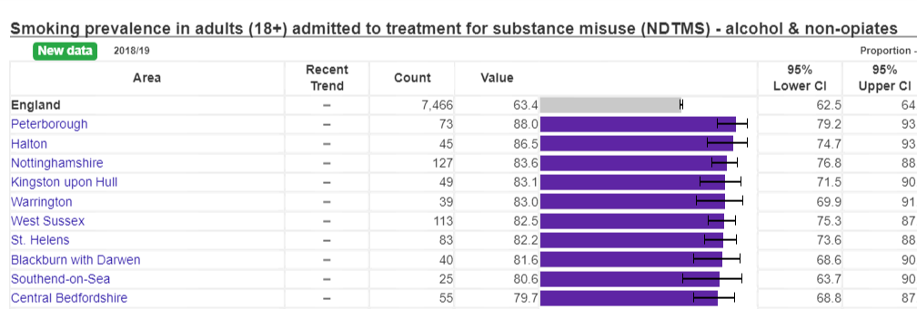
Smoking prevalence in adults admitted to treatment for alcohol & non-opiates

Slide 10
Smoking prevalence in adults admitted to treatment for non-opiates

Slide 11
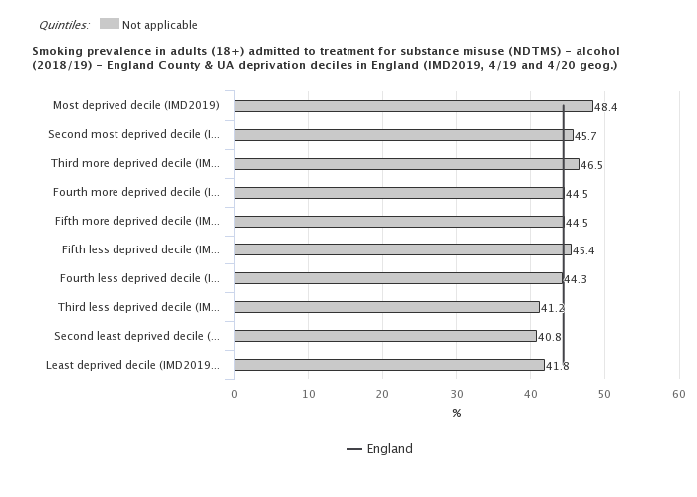
Smoking prevalence in adults admitted to treatment for alcohol only

Slide 12
Trends in smoking prevalence – all substance

Slide 13
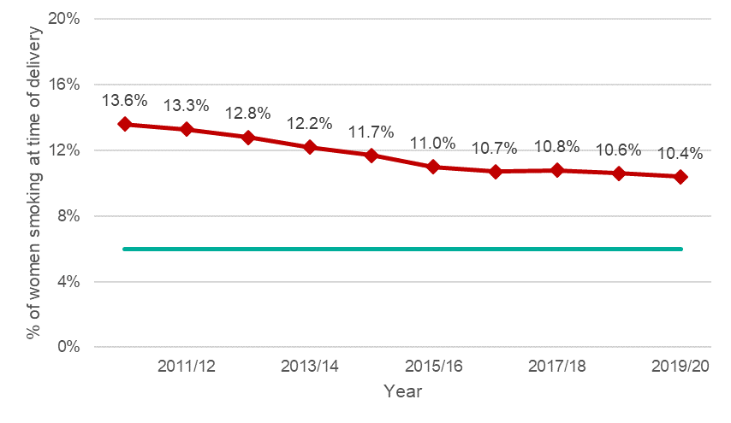
Smoking at time of delivery
10.4% of women were recorded as smokers at time of delivery in 2019/20.
6% target
The proportion of unknowns in the recording of smoking status remains a concern
(1.9% of maternities in 2019/20).

Slide 14
Smoking in pregnancy

Slide 15
Smoking in early pregnancy

Slide 16
Smoking Prevalence by housing tenure

Slide 17
Smoking Prevalence by housing tenure

Slide 18
Smoking-related deaths

Slide 20
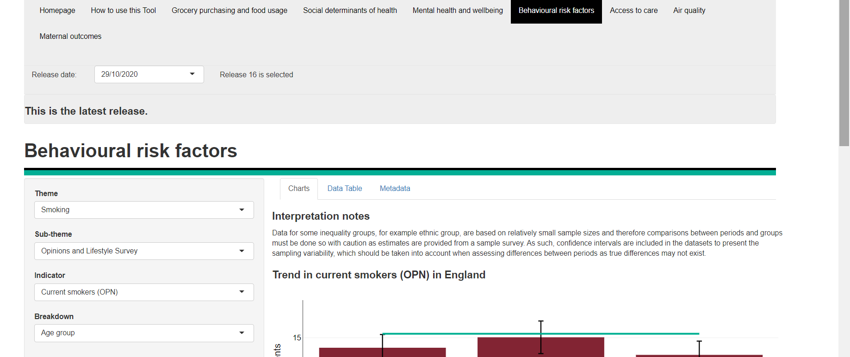
Wider Impacts of Covid on Health

Slide 21
WICH tool

Slide 22
WICH tool

Slide 23
Questions or feedback on the webinar
tobacco.profiles@phe.gov.uk

