Slide 1
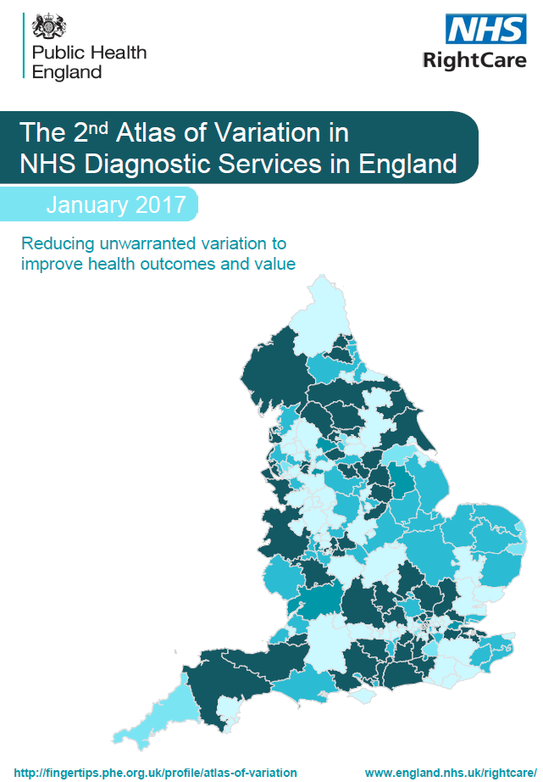
The 2nd Atlas of Variation in NHS Diagnostic Services in England
January 2017

Slide 2
Imaging Services
December 2016

Slide 3
Map 1
December 2016

Slide 4
Map 1: Rate of computed axial tomography (CT) activity per weighted population by CCG
Adjusted for age, sex and ‘need’, 2015/16
Domain 1: Preventing people from dying prematurely
OPTIMUM VALUE: REQUIRES LOCAL INTERPRETATION
LONDON
Contains Ordnance Survey data © Crown copyright and database right 2016
Contains National Statistics data © Crown copyright and database right 2016

Slide 5
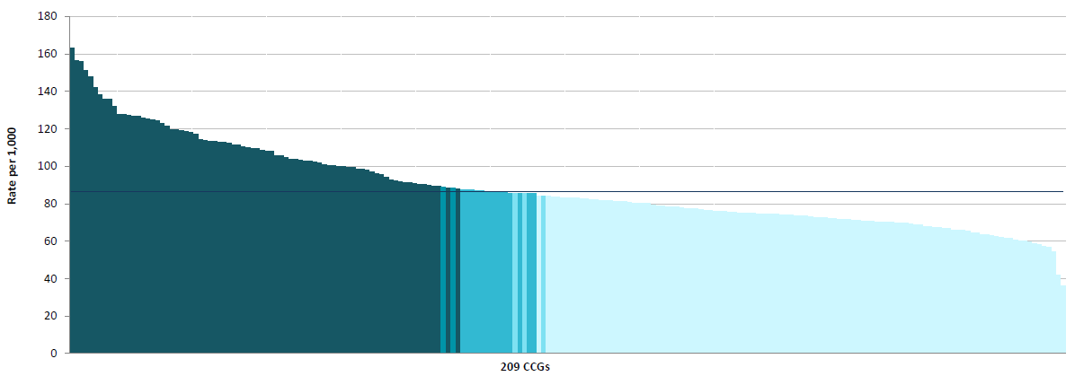
Column Chart 1: Rate of computed axial tomography (CT) activity per weighted population by CCG
Adjusted for age, sex and ‘need’, 2015/16
Domain 1: Preventing people from dying prematurely
OPTIMUM VALUE: REQUIRES LOCAL INTERPRETATION

Slide 6
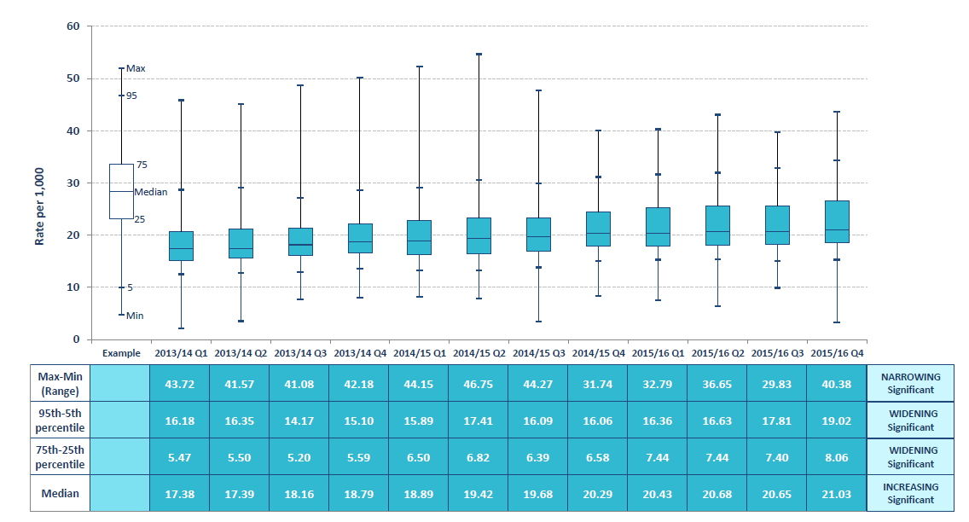
Box Plot 1: Rate of computed axial tomography (CT) activity per weighted population by CCG
Adjusted for age, sex and ‘need’, 2015/16
Domain 1: Preventing people from dying prematurely
OPTIMUM VALUE: REQUIRES LOCAL INTERPRETATION

Slide 7
Map 2
December 2016

Slide 8
Map 2: Rate of magnetic resonance imaging (MRI) activity per weighted population by CCG
Adjusted for age, sex and ‘need’, 2015/16
Domain 1: Preventing people from dying prematurely
OPTIMUM VALUE: REQUIRES LOCAL INTERPRETATION
LONDON
Contains Ordnance Survey data © Crown copyright and database right 2016
Contains National Statistics data © Crown copyright and database right 2016

Slide 9
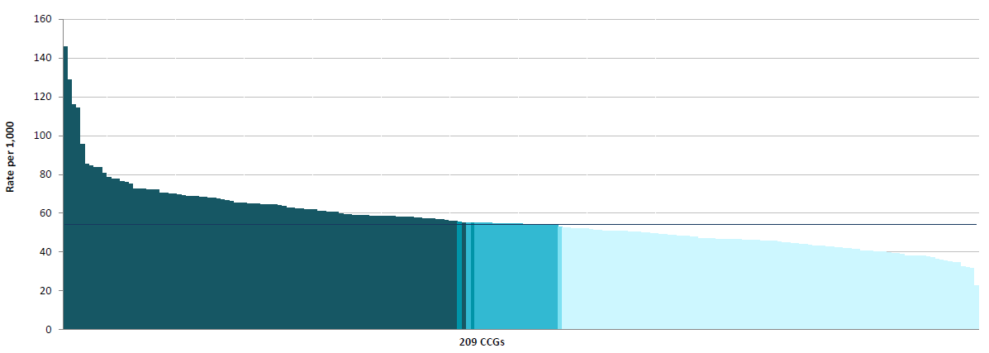
Column Chart 2: Rate of magnetic resonance imaging (MRI) activity per weighted population by CCG
Adjusted for age, sex and ‘need’, 2015/16
Domain 1: Preventing people from dying prematurely
OPTIMUM VALUE: REQUIRES LOCAL INTERPRETATION

Slide 10
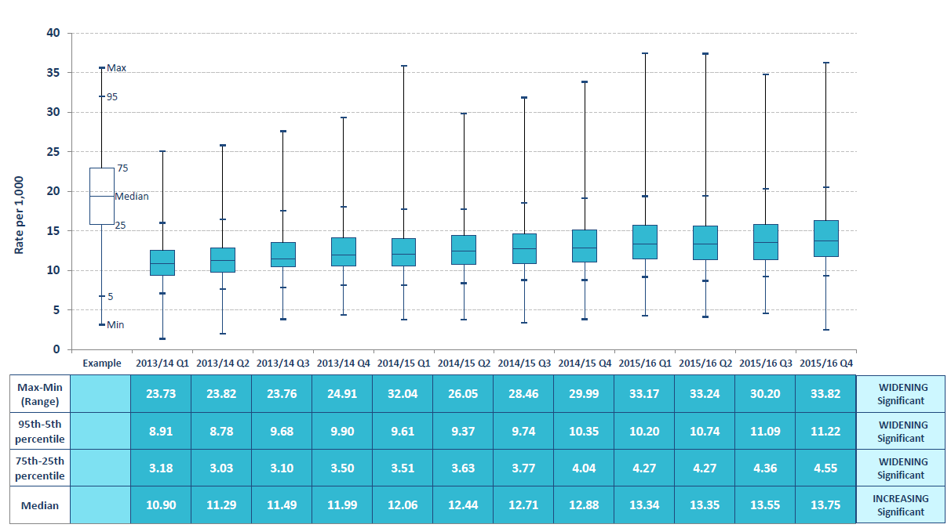
Box Plot 2: Rate of magnetic resonance imaging (MRI) activity per weighted population by CCG
Adjusted for age, sex and ‘need’, 2015/16
Domain 1: Preventing people from dying prematurely
OPTIMUM VALUE: REQUIRES LOCAL INTERPRETATION

Slide 11
Map 3
December 2016

Slide 12
Map 3: Rate of non-obstetric ultrasound activity per weighted population by CCG
Adjusted for age, sex and ‘need’, 2015/16
Domain 1: Preventing people from dying prematurely
OPTIMUM VALUE: REQUIRES LOCAL INTERPRETATION
LONDON
Contains Ordnance Survey data © Crown copyright and database right 2016
Contains National Statistics data © Crown copyright and database right 2016

Slide 13
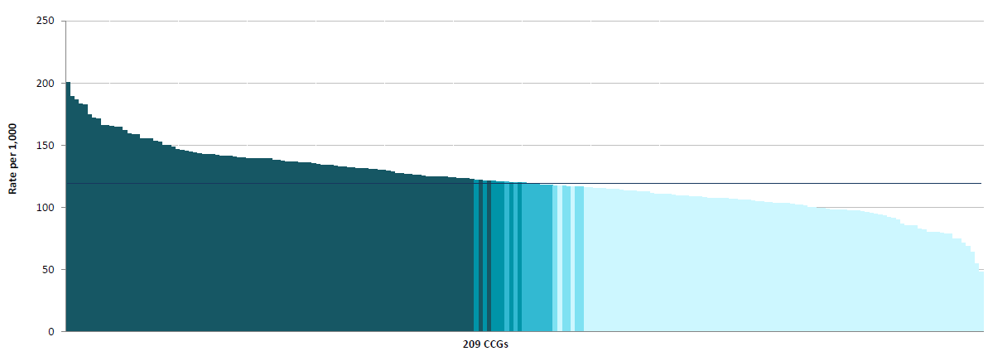
Column Chart 3: Rate of non-obstetric ultrasound activity per weighted population by CCG
Adjusted for age, sex and ‘need’, 2015/16
Domain 1: Preventing people from dying prematurely
OPTIMUM VALUE: REQUIRES LOCAL INTERPRETATION

Slide 14
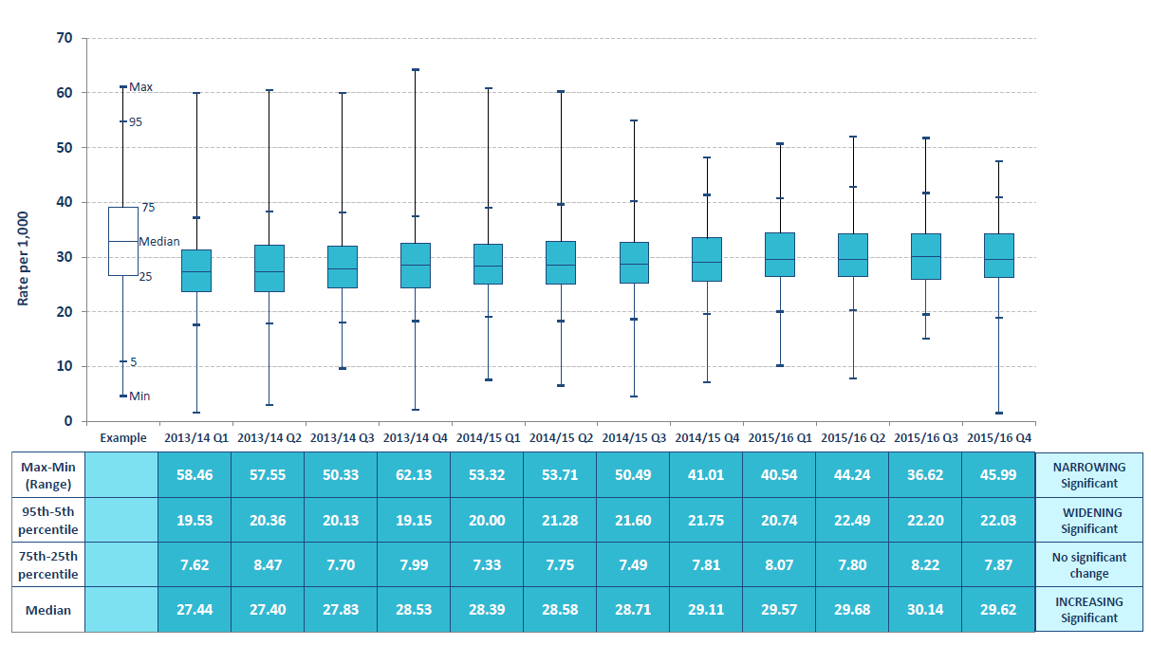
Box Plot 3: Rate of non-obstetric ultrasound activity per weighted population by CCG
Adjusted for age, sex and ‘need’, 2015/16
Domain 1: Preventing people from dying prematurely
OPTIMUM VALUE: REQUIRES LOCAL INTERPRETATION

Slide 15
Map 4a
December 2016

Slide 16
Map 4a: Median time (minutes) from arrival at hospital to brain imaging for stroke patients by CCG
October-December 2015
Domain 1: Preventing people from dying prematurely
Domain 2: Enhancing quality of life for people with long-term conditions
Domain 3: Helping people to recover from episodes of ill
health or following injury
OPTIMUM VALUE: LOW
LONDON
Contains Ordnance Survey data © Crown copyright and database right 2016
Contains National Statistics data © Crown copyright and database right 2016

Slide 17
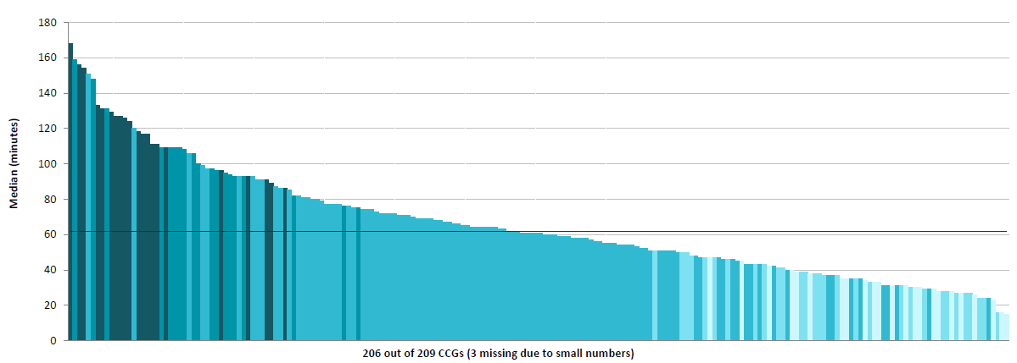
Column Chart 4a: Median time (minutes) from arrival at hospital to brain imaging for stroke patients by CCG
October-December 2015
Domain 1: Preventing people from dying prematurely
Domain 2: Enhancing quality of life for people with long-term conditions
Domain 3: Helping people to recover from episodes of ill
health or following injury
OPTIMUM VALUE: LOW

Slide 18
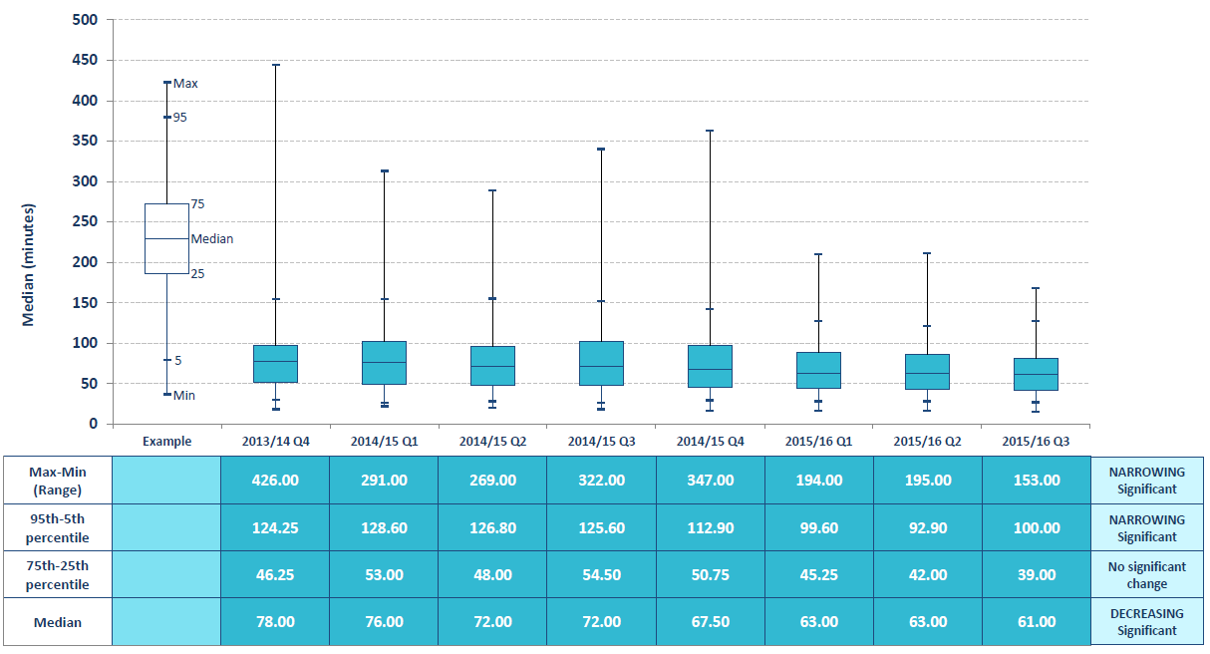
Box Plot 4a: Median time (minutes) from arrival at hospital to brain imaging for stroke patients by CCG
October-December 2015
Domain 1: Preventing people from dying prematurely
Domain 2: Enhancing quality of life for people with long-term conditions
Domain 3: Helping people to recover from episodes of ill
health or following injury
OPTIMUM VALUE: LOW

Slide 19
Map 4b
December 2016

Slide 20
Map 4b: Median time (minutes) from arrival at hospital to brain imaging for stroke patients by stroke team
October-December 2015
Domain 1: Preventing people from dying prematurely
Domain 2: Enhancing quality of life for people with long-term conditions
Domain 3: Helping people to recover from episodes of ill
health or following injury
OPTIMUM VALUE: LOW
LONDON
Contains Ordnance Survey data © Crown copyright and database right 2016
Contains National Statistics data © Crown copyright and database right 2016

Slide 21
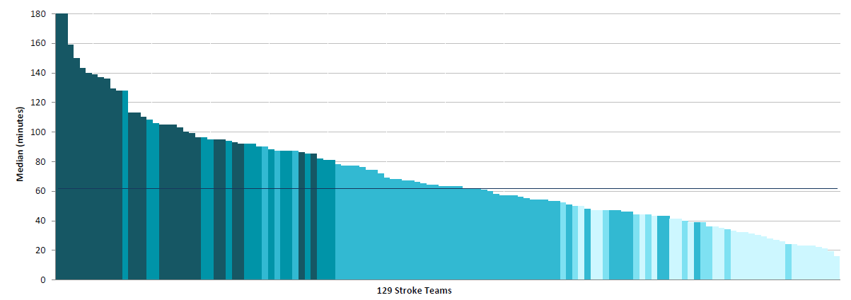
Column Chart 4b: Median time (minutes) from arrival at hospital to brain imaging for stroke patients by stroke team
October-December 2015
Domain 1: Preventing people from dying prematurely
Domain 2: Enhancing quality of life for people with long-term conditions
Domain 3: Helping people to recover from episodes of ill
health or following injury
OPTIMUM VALUE: LOW

Slide 22
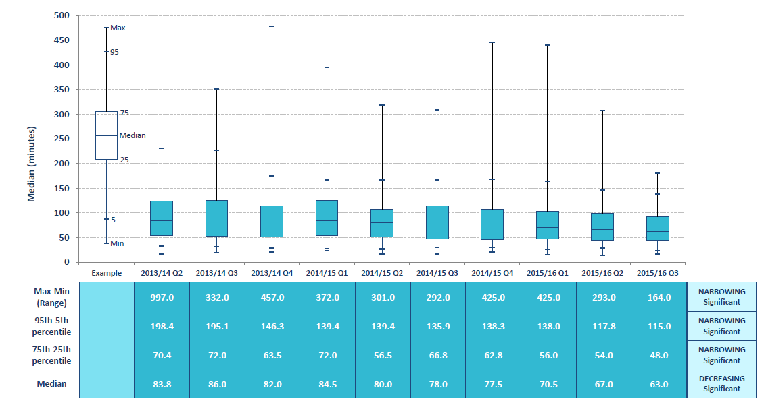
Box Plot 4b: Median time (minutes) from arrival at hospital to brain imaging for stroke patients by stroke team
October-December 2015
Domain 1: Preventing people from dying prematurely
Domain 2: Enhancing quality of life for people with long-term conditions
Domain 3: Helping people to recover from episodes of ill
health or following injury
OPTIMUM VALUE: LOW

Slide 23
Map 5a
December 2016

Slide 24
Map 5a: Percentage of stroke patients undergoing brain imaging within one hour of arrival at hospital by CCG
October-December 2015
Domain 1: Preventing people from dying prematurely
Domain 2: Enhancing quality of life for people with long-term conditions
Domain 3: Helping people to recover from episodes of ill
health or following injury
OPTIMUM VALUE: HIGH
LONDON
Contains Ordnance Survey data © Crown copyright and database right 2016
Contains National Statistics data © Crown copyright and database right 2016

Slide 25
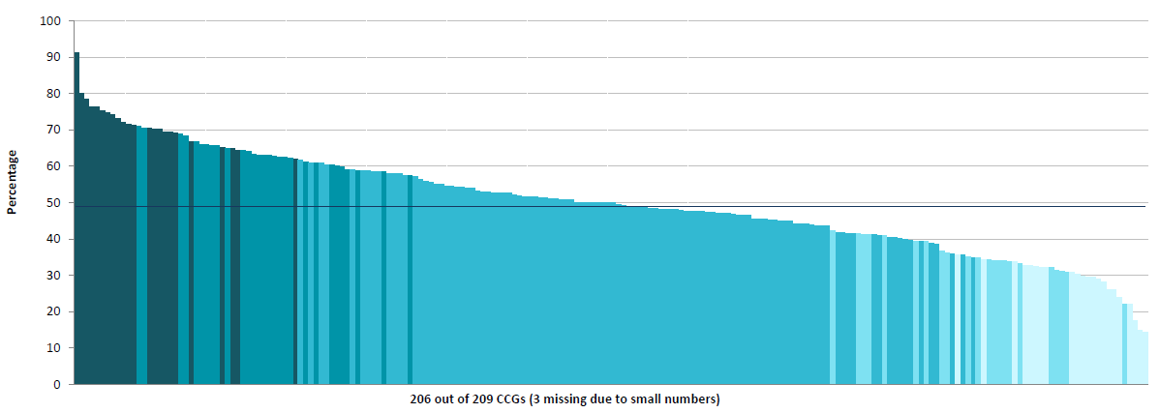
Column Chart 5a: Percentage of stroke patients undergoing brain imaging within one hour of arrival at hospital by CCG
October-December 2015
Domain 1: Preventing people from dying prematurely
Domain 2: Enhancing quality of life for people with long-term conditions
Domain 3: Helping people to recover from episodes of ill
health or following injury
OPTIMUM VALUE: HIGH

Slide 26
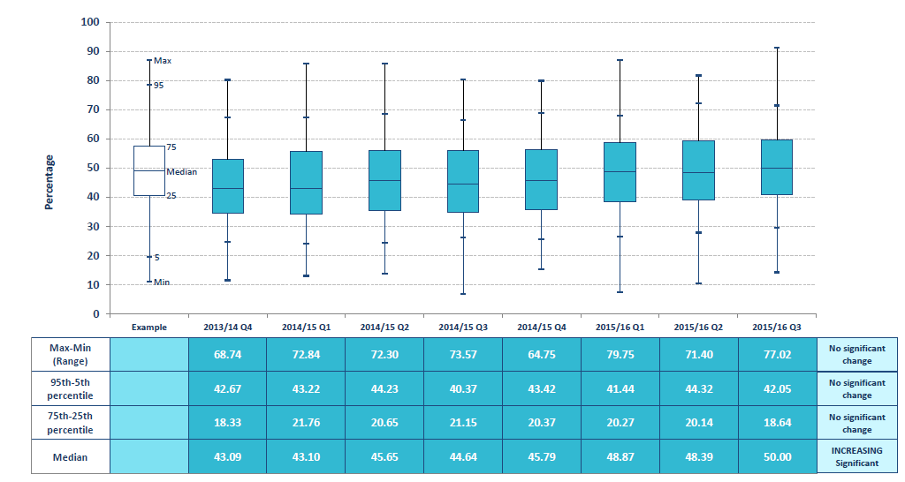
Box Plot 5a: Percentage of stroke patients undergoing brain imaging within one hour of arrival at hospital by CCG
October-December 2015
Domain 1: Preventing people from dying prematurely
Domain 2: Enhancing quality of life for people with long-term conditions
Domain 3: Helping people to recover from episodes of ill
health or following injury
OPTIMUM VALUE: HIGH

Slide 27
Map 5b
December 2016

Slide 28
Map 5b: Percentage of stroke patients undergoing brain imaging within one hour of arrival at hospital by stroke team
October-December 2015
Domain 1: Preventing people from dying prematurely
Domain 2: Enhancing quality of life for people with long-term conditions
Domain 3: Helping people to recover from episodes of ill
health or following injury
OPTIMUM VALUE: HIGH
LONDON
Contains Ordnance Survey data © Crown copyright and database right 2016
Contains National Statistics data © Crown copyright and database right 2016

Slide 29
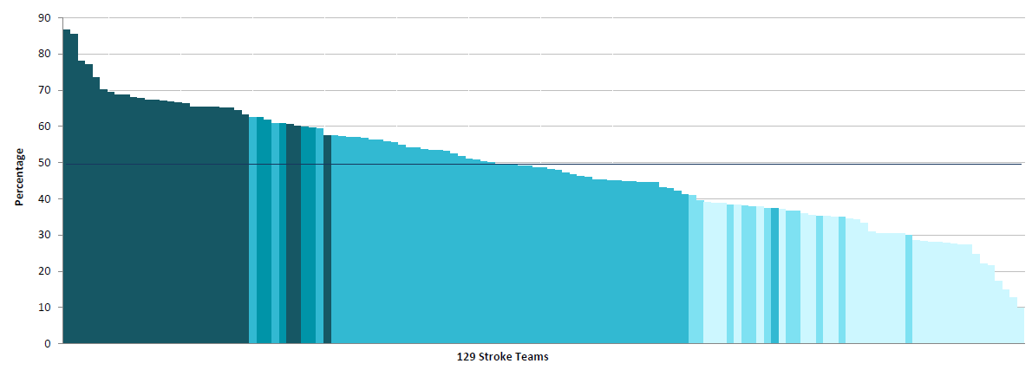
Column Chart 5b: Percentage of stroke patients undergoing brain imaging within one hour of arrival at hospital by stroke team
October-December 2015
Domain 1: Preventing people from dying prematurely
Domain 2: Enhancing quality of life for people with long-term conditions
Domain 3: Helping people to recover from episodes of ill
health or following injury
OPTIMUM VALUE: HIGH

Slide 30
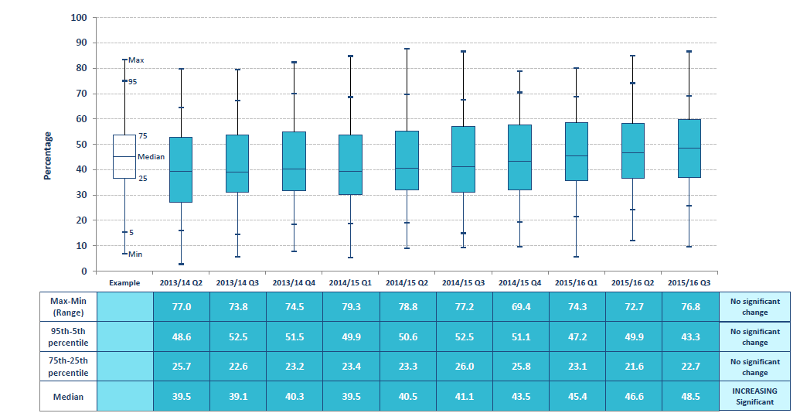
Box Plot 5b: Percentage of stroke patients undergoing brain imaging within 1 hour of arrival at hospital by stroke team
October-December 2015
Domain 1: Preventing people from dying prematurely
Domain 2: Enhancing quality of life for people with long-term conditions
Domain 3: Helping people to recover from episodes of ill
health or following injury
OPTIMUM VALUE: HIGH

Slide 31
Map 6a
December 2016

Slide 32
Map 6a: Percentage of stroke patients undergoing brain imaging within 12 hours of arrival at hospital by CCG
October-December 2015
Domain 1: Preventing people from dying prematurely
Domain 2: Enhancing quality of life for people with long-term conditions
Domain 3: Helping people to recover from episodes of ill
health or following injury
OPTIMUM VALUE: HIGH
LONDON
Contains Ordnance Survey data © Crown copyright and database right 2016
Contains National Statistics data © Crown copyright and database right 2016

Slide 33
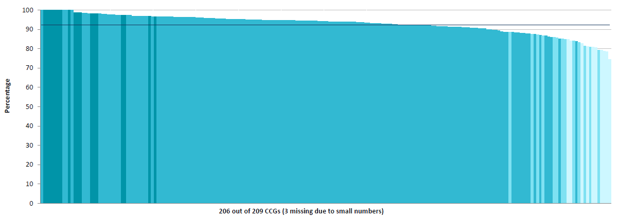
Column Chart 6a: Percentage of stroke patients undergoing brain imaging within 12 hours of arrival at hospital by CCG
October-December 2015
Domain 1: Preventing people from dying prematurely
Domain 2: Enhancing quality of life for people with long-term conditions
Domain 3: Helping people to recover from episodes of ill
health or following injury
OPTIMUM VALUE: HIGH

Slide 34
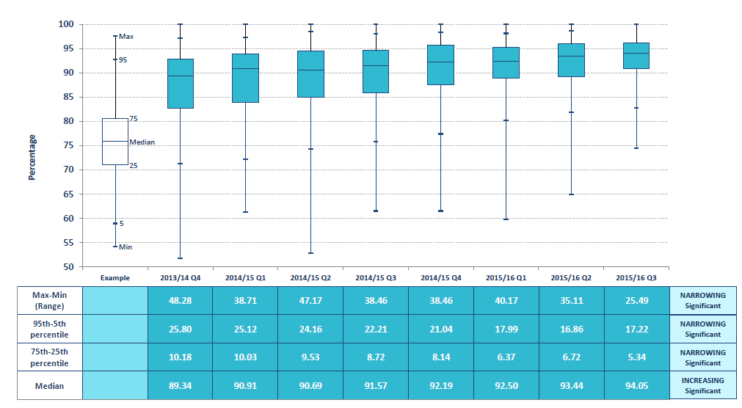
Box Plot 6a: Percentage of stroke patients undergoing brain imaging within 12 hours of arrival at hospital by CCG
October-December 2015
Domain 1: Preventing people from dying prematurely
Domain 2: Enhancing quality of life for people with long-term conditions
Domain 3: Helping people to recover from episodes of ill
health or following injury
OPTIMUM VALUE: HIGH

Slide 35
Map 6b
December 2016

Slide 36
Map 6b: Percentage of stroke patients undergoing brain imaging within 12 hours of arrival at hospital by stroke team
October-December 2015
Domain 1: Preventing people from dying prematurely
Domain 2: Enhancing quality of life for people with long-term conditions
Domain 3: Helping people to recover from episodes of ill
health or following injury
OPTIMUM VALUE: HIGH
LONDON
Contains Ordnance Survey data © Crown copyright and database right 2016
Contains National Statistics data © Crown copyright and database right 2016

Slide 37
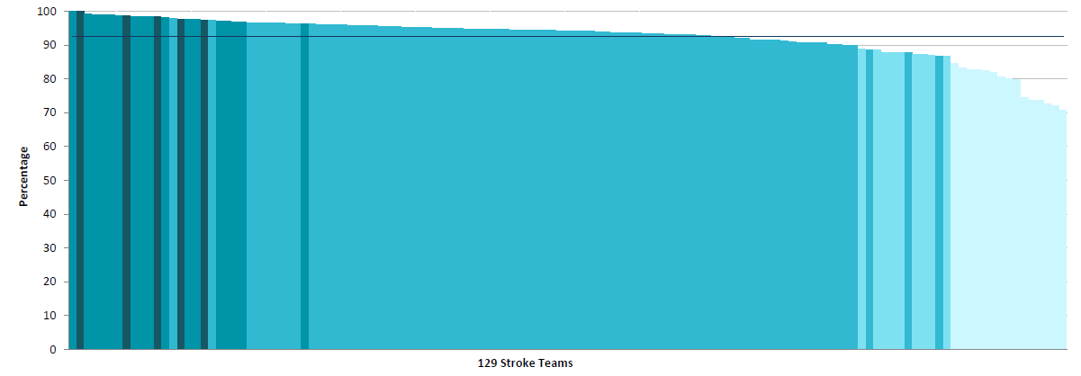
Column Chart 6b: Percentage of stroke patients undergoing brain imaging within 12 hours of arrival at hospital by stroke team
October-December 2015
Domain 1: Preventing people from dying prematurely
Domain 2: Enhancing quality of life for people with long-term conditions
Domain 3: Helping people to recover from episodes of ill
health or following injury
OPTIMUM VALUE: HIGH

Slide 38
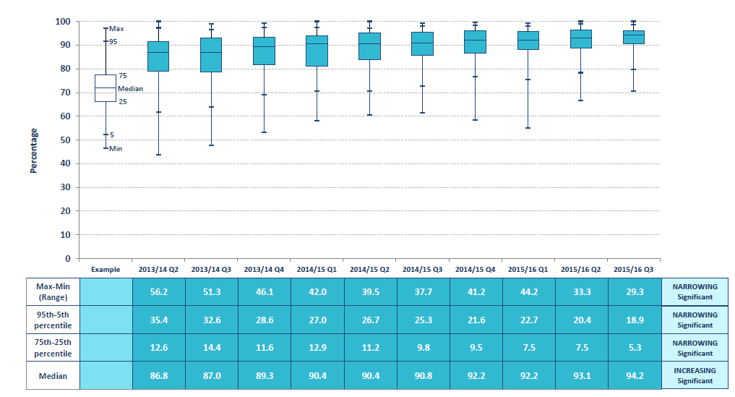
Box Plot 6b: Percentage of stroke patients undergoing brain imaging within 12 hours of arrival at hospital by stroke team
October-December 2015
Domain 1: Preventing people from dying prematurely
Domain 2: Enhancing quality of life for people with long-term conditions
Domain 3: Helping people to recover from episodes of ill
health or following injury
OPTIMUM VALUE: HIGH

Slide 39
Map 7
December 2016

Slide 40

Map 7: Median time (minutes) to head computed axial tomography (CT) for patients admitted directly to hospital meeting NICE head injury guidelines by NHS Trust
2014/15
Domain 1: Preventing people from dying prematurely
OPTIMUM VALUE: LOW
LONDON
Contains Ordnance Survey data © Crown copyright and database right 2016
Contains National Statistics data © Crown copyright and database right 2016

Slide 41
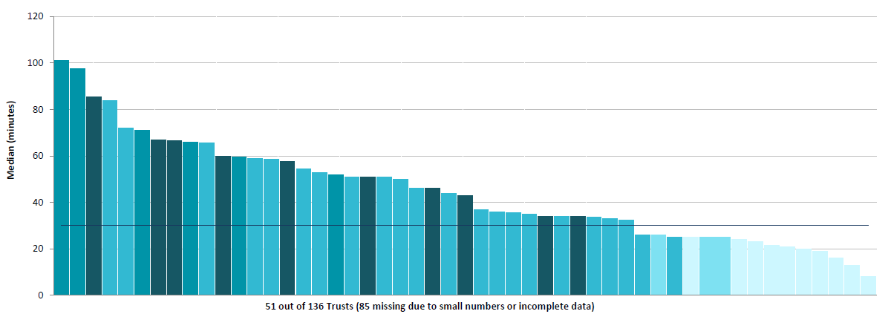
Column Chart 7: Median time (minutes) to head computed axial tomography (CT) for patients admitted directly to hospital meeting NICE head injury guidelines by NHS Trust
2014/15
Domain 1: Preventing people from dying prematurely
OPTIMUM VALUE: LOW

Slide 42
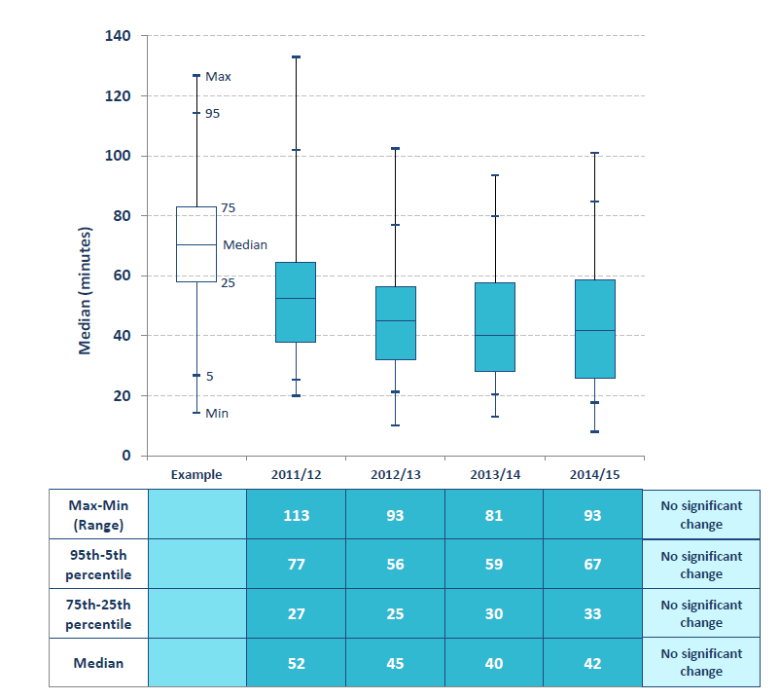
Box Plot 7: Median time (minutes) to head computed axial tomography (CT) for patients admitted directly to hospital meeting NICE head injury guidelines by NHS Trust
2014/15
Domain 1: Preventing people from dying
prematurely
OPTIMUM VALUE: LOW

Slide 43
Map 8
December 2016

Slide 44
Map 8: Median time (minutes) to pelvic computed axial tomography (CT) for patients admitted directly to hospital with pelvic injury by NHS Trust
2014/15
Domain 1: Preventing people from dying prematurely
OPTIMUM VALUE: LOW
LONDON
Contains Ordnance Survey data © Crown copyright and database right 2016
Contains National Statistics data © Crown copyright and database right 2016

Slide 45
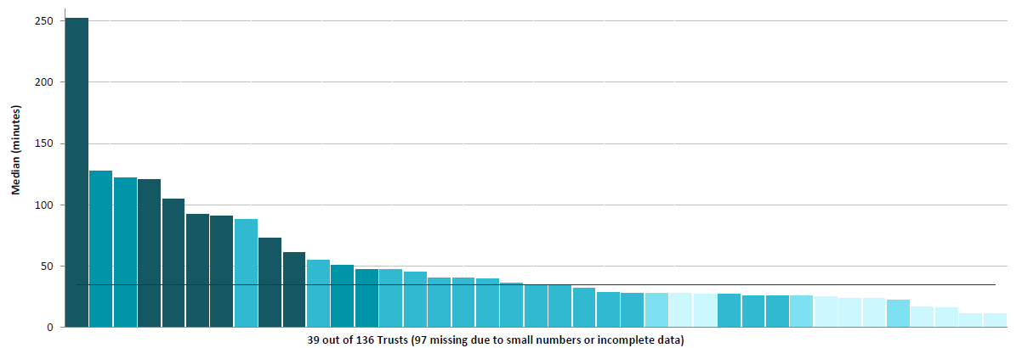
Column Chart 8: Median time (minutes) to pelvic computed axial tomography (CT) for patients admitted directly to hospital with pelvic injury by NHS Trust
2014/15
Domain 1: Preventing people from dying prematurely
OPTIMUM VALUE: LOW

Slide 46
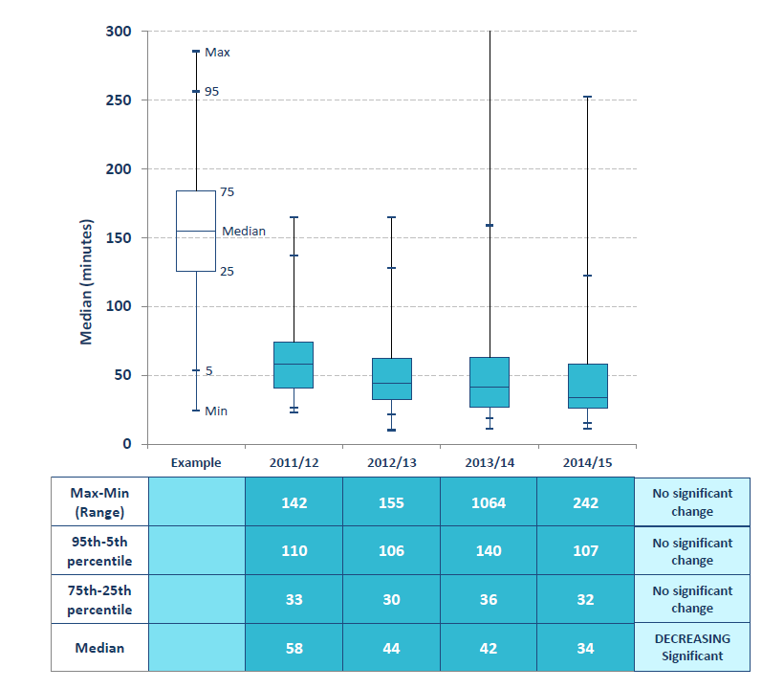
Box Plot 8: Median time (minutes) to pelvic computed axial tomography (CT) for patients admitted directly to hospital with pelvic injury by NHS Trust
2014/15
Domain 1: Preventing people from dying prematurely
OPTIMUM VALUE: LOW

Slide 47
Map 9
December 2016

Slide 48
Map 9: Rate of endovascular aneurysm repair (EVAR) procedures for abdominal aortic aneurysm (AAA) per population by CCG
Directly standardised for age, 2012/13-2014/15
Domain 1: Preventing people from dying prematurely
OPTIMUM VALUE: REQUIRES LOCAL INTERPRETATION
LONDON
Contains Ordnance Survey data © Crown copyright and database right 2016
Contains National Statistics data © Crown copyright and database right 2016

Slide 49
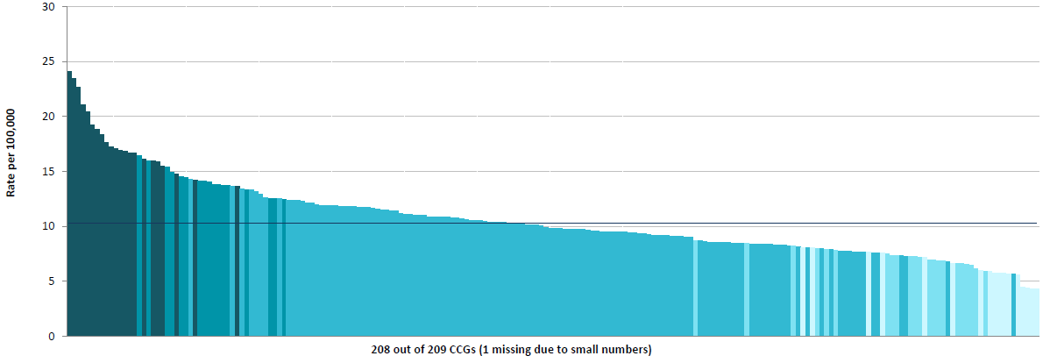
Column Chart 9: Rate of endovascular aneurysm repair (EVAR) procedures for abdominal aortic aneurysm (AAA) per population by CCG
Directly standardised for age, 2012/13-2014/15
Domain 1: Preventing people from dying prematurely
OPTIMUM VALUE: REQUIRES LOCAL INTERPRETATION

Slide 50
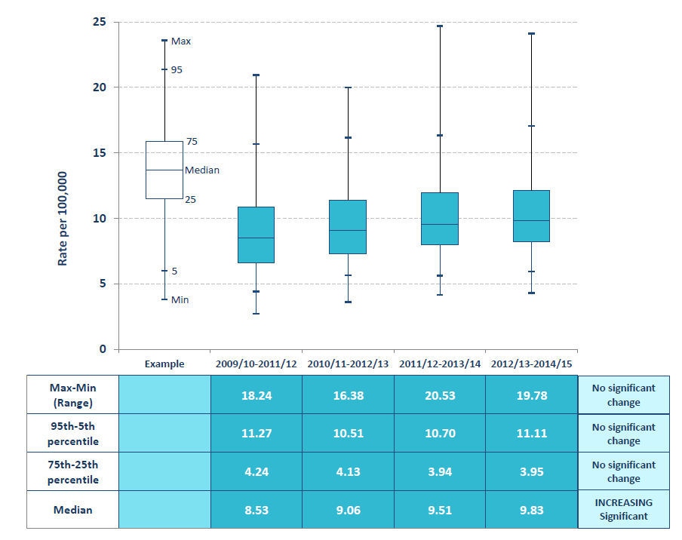
Box Plot 9: Rate of endovascular aneurysm repair (EVAR) procedures for abdominal aortic aneurysm (AAA) per population by CCG
Directly standardised for age, 2012/13-2014/15
Domain 1: Preventing people from dying prematurely
OPTIMUM VALUE: REQUIRES LOCAL INTERPRETATION

Slide 51
Map 10
December 2016

Slide 52
Map 10: Percentage of elective procedures for abdominal aortic aneurysm (AAA) that were EVAR by CCG
2012/13-2014/15
Domain 1: Preventing people from dying prematurely
OPTIMUM VALUE: REQUIRES LOCAL INTERPRETATION
LONDON
Contains Ordnance Survey data © Crown copyright and database right 2016
Contains National Statistics data © Crown copyright and database right 2016

Slide 53
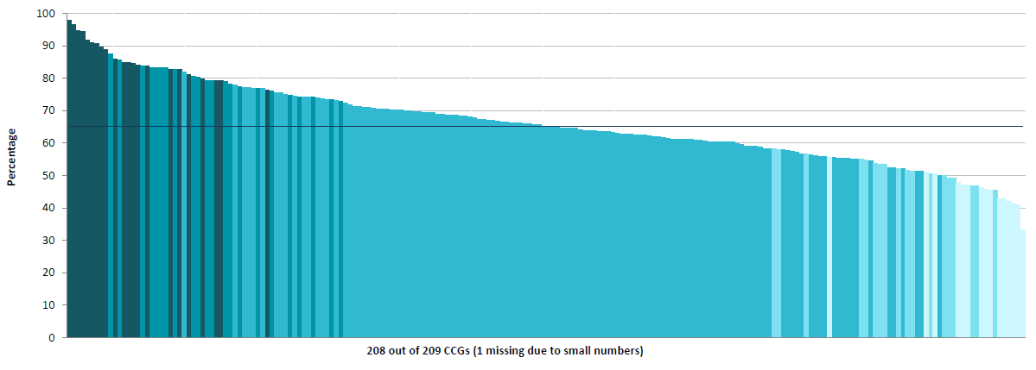
Column Chart 10: Percentage of elective procedures for abdominal aortic aneurysm (AAA) that were EVAR by CCG
2012/13-2014/15
Domain 1: Preventing people from dying prematurely
OPTIMUM VALUE: REQUIRES LOCAL INTERPRETATION

Slide 54
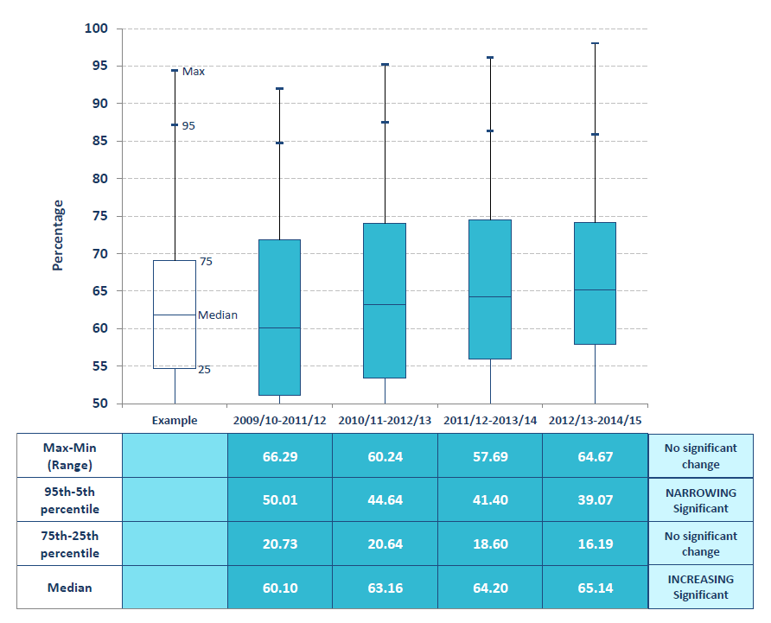
Box Plot 10: Percentage of elective procedures for abdominal aortic aneurysm (AAA) that were EVAR by CCG
2012/13-2014/15
Domain 1: Preventing people from dying prematurely
OPTIMUM VALUE: REQUIRES LOCAL INTERPRETATION

Slide 55
Map 11
December 2016

Slide 56
Map 11: Percentage of NHS hospital Trusts that had formal arrangements for 24-hour access to nephrostomy by strategic health authority
2013
Domain 1: Preventing people from dying prematurely
OPTIMUM VALUE: HIGH
SHA variation
IR provision at NHS Trusts
LONDON
Contains Ordnance Survey data © Crown copyright and database right 2016
Contains National Statistics data © Crown copyright and database right 2016

Slide 57
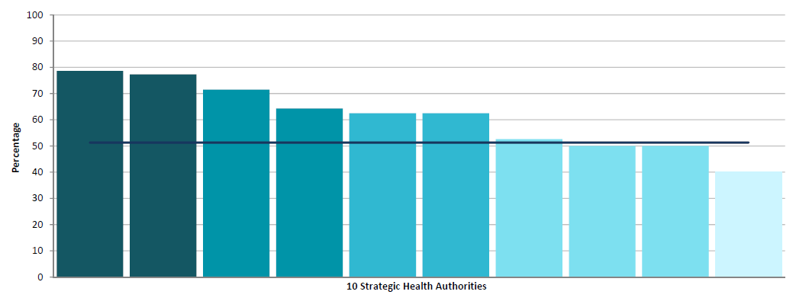
Column Chart 11: Percentage of NHS hospital Trusts that had formal arrangements for 24-hour access to nephrostomy by strategic health authority
2013
Domain 1: Preventing people from dying prematurely
OPTIMUM VALUE: HIGH
SHA variation

Slide 58
Map 12
December 2016

Slide 59
Map 12: Percentage of NHS hospital Trusts that had formal arrangements for 24-hour access to endovascular intervention by strategic health authority
2013
Domain 1: Preventing people from dying prematurely
OPTIMUM VALUE: HIGH
SHA variation
IR provision at NHS Trusts
LONDON
Contains Ordnance Survey data © Crown copyright and database right 2016
Contains National Statistics data © Crown copyright and database right 2016

Slide 60
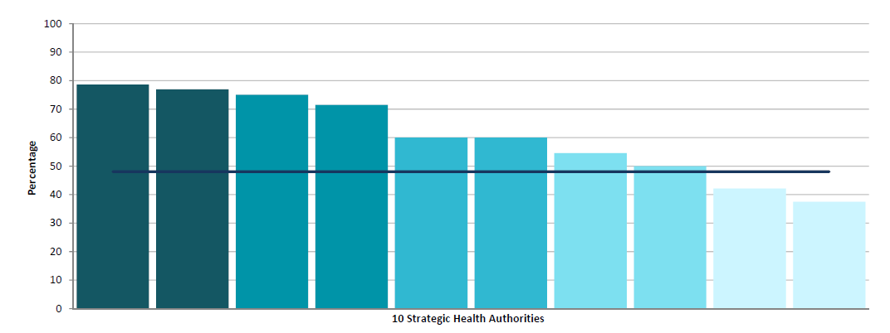
Column Chart 12: Percentage of NHS hospital Trusts that had formal arrangements for 24-hour access to endovascular intervention by strategic health authority
2013
Domain 1: Preventing people from dying prematurely
OPTIMUM VALUE: HIGH
SHA variation

Slide 61
Map 13
December 2016

Slide 62
Map 13: Percentage of NHS hospital Trusts that had formal arrangements for 24-hour access to embolisation for haemorrhage by strategic health authority
2013
Domain 1: Preventing people from dying prematurely
OPTIMUM VALUE: HIGH
SHA variation
IR provision at NHS Trusts
Contains Ordnance Survey data © Crown copyright and database right 2016
Contains National Statistics data © Crown copyright and database right 2016

Slide 63
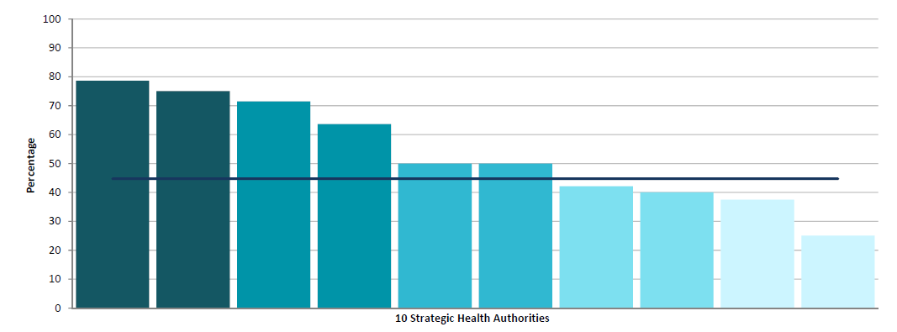
Column Chart 13: Percentage of NHS hospital Trusts that had formal arrangements for 24-hour access to embolisation for haemorrhage by strategic health authority
2013
Domain 1: Preventing people from dying prematurely
OPTIMUM VALUE: HIGH
SHA variation

Slide 64
Map 14
December 2016

Slide 65
Map 14: Percentage of NHS hospital Trusts that had formal arrangements for 24-hour access to embolisation for post-partum haemorrhage by strategic health authority
2013
Domain 1: Preventing people from dying prematurely
OPTIMUM VALUE: HIGH
SHA variation
IR provision at NHS Trusts
Contains Ordnance Survey data © Crown copyright and database right 2016
Contains National Statistics data © Crown copyright and database right 2016

Slide 66
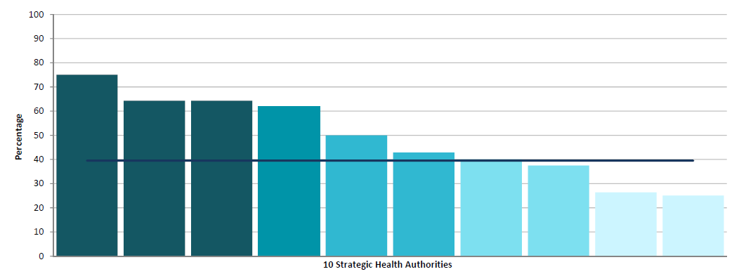
Column Chart 14: Percentage of NHS hospital Trusts that had formal arrangements for 24-hour access to embolisation for post-partum haemorrhage by strategic health authority
2013
Domain 1: Preventing people from dying prematurely
OPTIMUM VALUE: HIGH
SHA variation

Slide 67
Map 15
December 2016

Slide 68
Map 15: Rate of dual-energy X-ray absorptiometry (DEXA) activity per weighted population by CCG
Adjusted for age, sex and ‘need’ , January – March 2016
Domain 2: Enhancing quality of life for people with long-term conditions
OPTIMUM VALUE: REQUIRES LOCAL INTERPRETATION
LONDON
Contains Ordnance Survey data © Crown copyright and database right 2016
Contains National Statistics data © Crown copyright and database right 2016

Slide 69
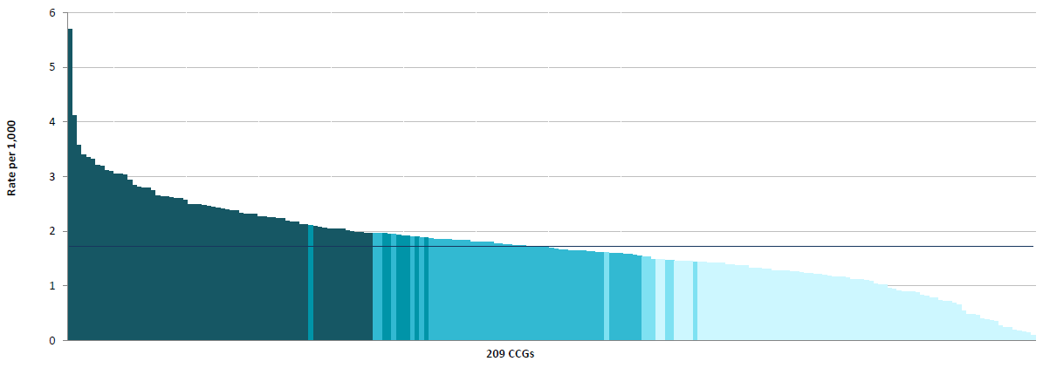
Column Chart 15: Rate of dual-energy X-ray absorptiometry (DEXA) activity per weighted population by CCG
Adjusted for age, sex and ‘need’ , January – March 2016
Domain 2: Enhancing quality of life for people with long-term conditions
OPTIMUM VALUE: REQUIRES LOCAL INTERPRETATION

Slide 70
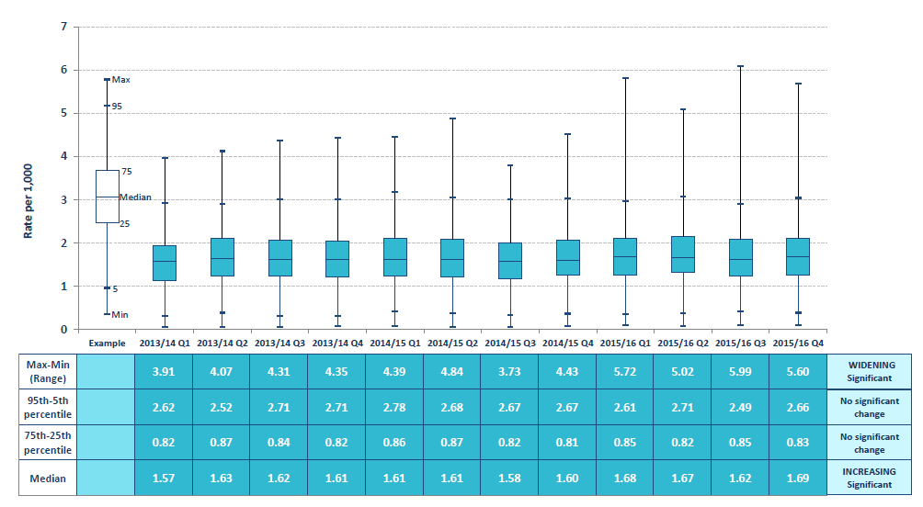
Box Plot 15: Rate of dual-energy X-ray absorptiometry (DEXA) activity per weighted population by CCG
Adjusted for age, sex and ‘need’ , January – March 2016
Domain 2: Enhancing quality of life for people with long-term conditions
OPTIMUM VALUE: REQUIRES LOCAL INTERPRETATION

Slide 71
Map 16
December 2016

Slide 72
Map 16: Rate of colonoscopy procedures and flexible sigmoidoscopy procedures per population by CCG
Indirectly standardised for age, sex and deprivation, 2014/15
Domain 1: Preventing people from dying prematurely
OPTIMUM VALUE: REQUIRES LOCAL INTERPRETATION
LONDON
Contains Ordnance Survey data © Crown copyright and database right 2016
Contains National Statistics data © Crown copyright and database right 2016

Slide 73
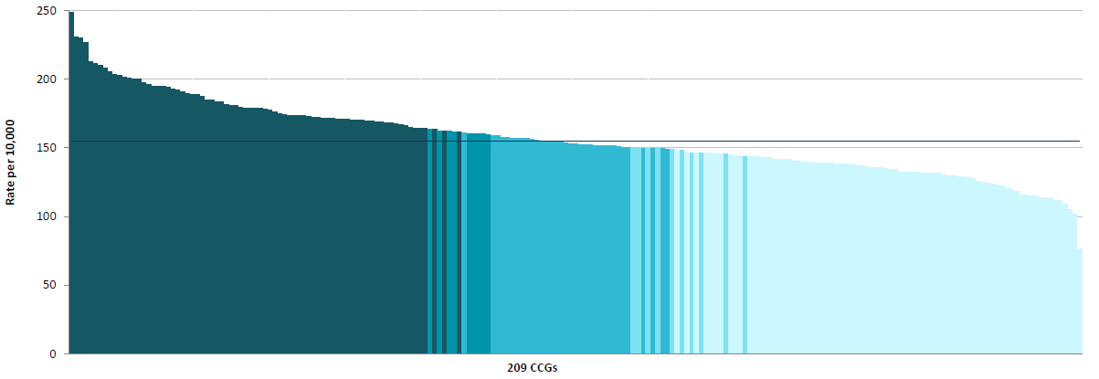
Column Chart 16: Rate of colonoscopy procedures and flexible sigmoidoscopy procedures per population by CCG
Indirectly standardised for age, sex and deprivation, 2014/15
Domain 1: Preventing people from dying prematurely
OPTIMUM VALUE: REQUIRES LOCAL INTERPRETATION

Slide 74
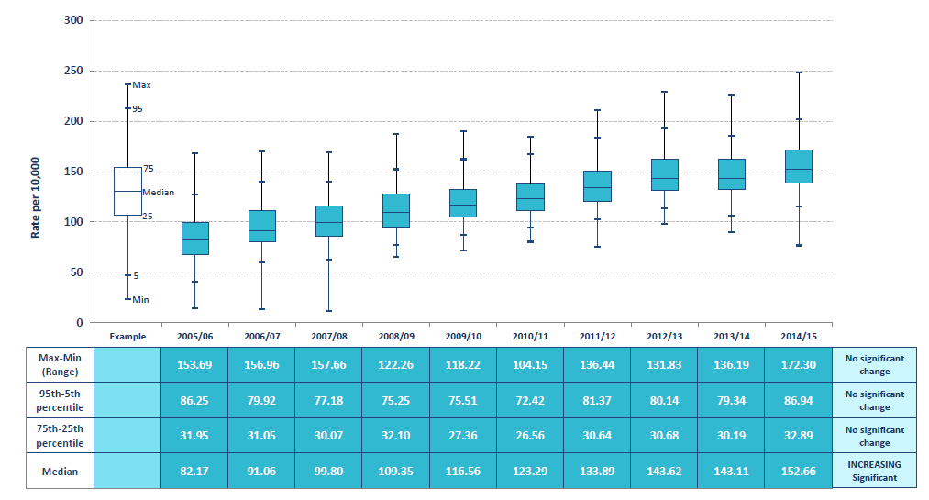
Box Plot 16: Rate of colonoscopy procedures and flexible sigmoidoscopy procedures per population by CCG
Indirectly standardised for age, sex and deprivation, 2014/15
Domain 1: Preventing people from dying prematurely
OPTIMUM VALUE: REQUIRES LOCAL INTERPRETATION

Slide 75
Endoscopy Services
December 2016

Slide 76
Map 17
December 2016

Slide 77
Map 17: Rate of computed tomography (CT) colonography procedures per weighted population by CCG
Adjusted for age, sex and ‘need’, 2014/15
Domain 1: Preventing people from dying prematurely
OPTIMUM VALUE: REQUIRES LOCAL INTERPRETATION
LONDON
Contains Ordnance Survey data © Crown copyright and database right 2016
Contains National Statistics data © Crown copyright and database right 2016

Slide 78
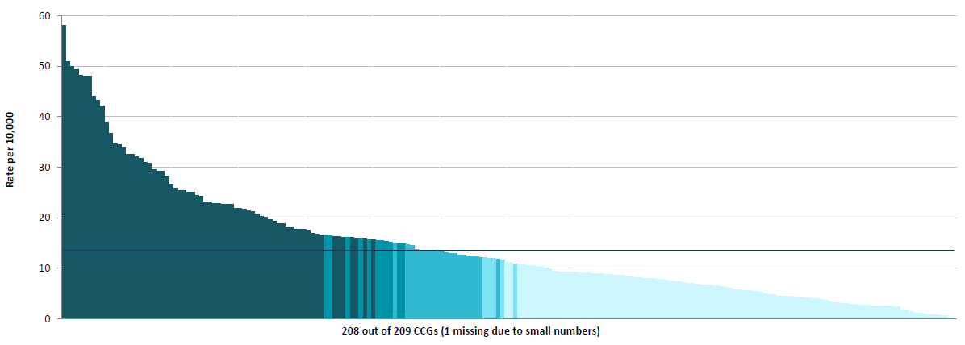
Column Chart 17: Rate of computed tomography (CT) colonography procedures per weighted population by CCG
Adjusted for age, sex and ‘need’, 2014/15
Domain 1: Preventing people from dying prematurely
OPTIMUM VALUE: REQUIRES LOCAL INTERPRETATION

Slide 79
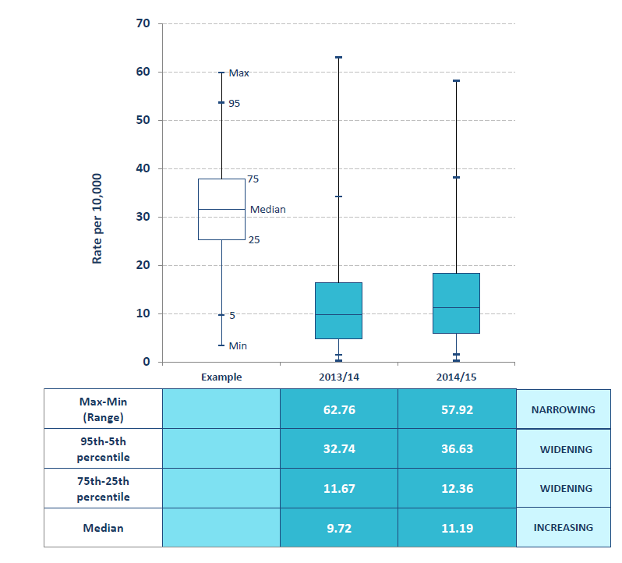
Box Plot 17: Rate of computed tomography (CT) colonography procedures per weighted population by CCG
Adjusted for age, sex and ‘need’, 2014/15
Domain 1: Preventing people from dying prematurely
OPTIMUM VALUE: REQUIRES LOCAL INTERPRETATION

Slide 80
Map 18
December 2016

Slide 81
Map 18: Rate of barium enema procedures per weighted population by CCG
Adjusted for age, sex and ‘need’, 2015/16
Domain 1: Preventing people from dying prematurely
OPTIMUM VALUE: LOW
LONDON
Contains Ordnance Survey data © Crown copyright and database right 2016
Contains National Statistics data © Crown copyright and database right 2016

Slide 82
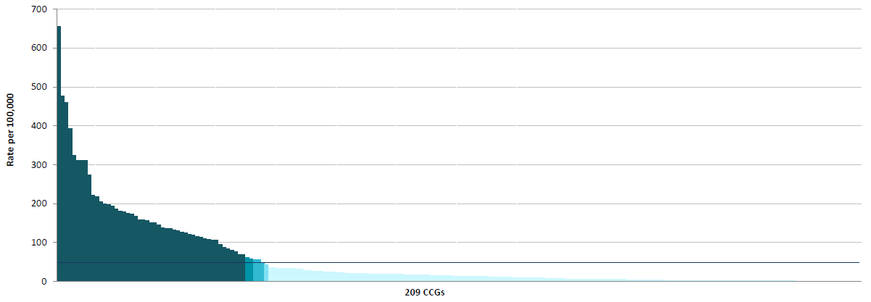
Column Chart 18: Rate of barium enema procedures per weighted population by CCG
Adjusted for age, sex and ‘need’, 2015/16
Domain 1: Preventing people from dying prematurely
OPTIMUM VALUE: LOW

Slide 83
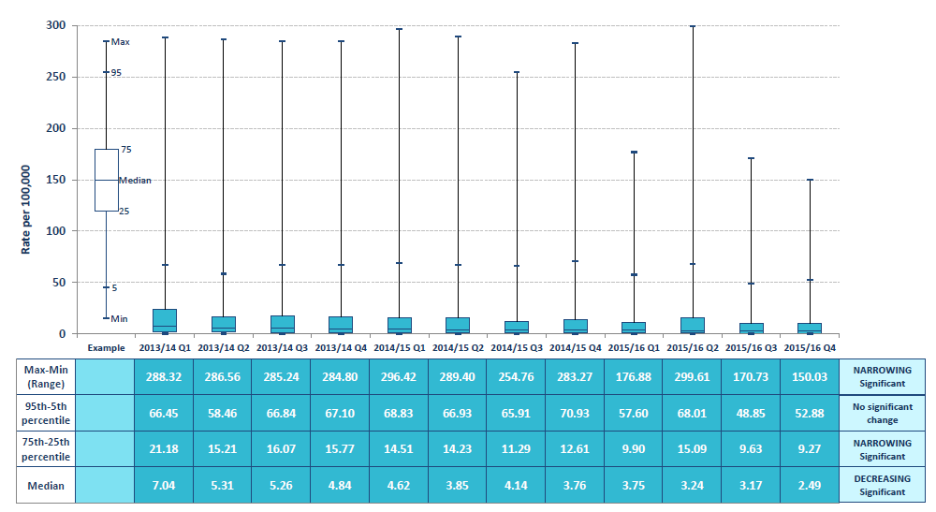
Box Plot 18: Rate of barium enema procedures per weighted population by CCG
Adjusted for age, sex and ‘need’, 2015/16
Domain 1: Preventing people from dying prematurely
OPTIMUM VALUE: LOW

Slide 84
Map 19
December 2016

Slide 85
Map 19: Rate of gastroscopy (upper gastrointestinal endoscopy) procedures per population by CCG
Indirectly standardised for age, sex and deprivation, 2014/15
Domain 1: Preventing people from dying prematurely
OPTIMUM VALUE: REQUIRES LOCAL INTERPRETATION
LONDON
Contains Ordnance Survey data © Crown copyright and database right 2016
Contains National Statistics data © Crown copyright and database right 2016

Slide 86
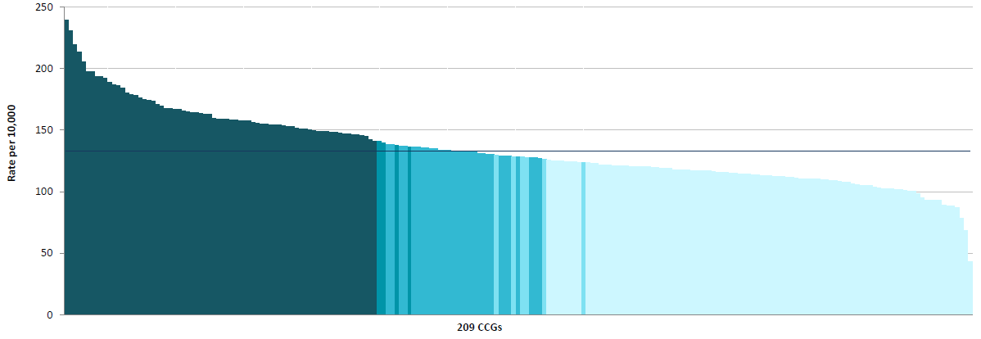
Column Chart 19: Rate of gastroscopy (upper gastrointestinal endoscopy) procedures per population by CCG
Indirectly standardised for age, sex and deprivation, 2014/15
Domain 1: Preventing people from dying prematurely
OPTIMUM VALUE: REQUIRES LOCAL INTERPRETATION

Slide 87
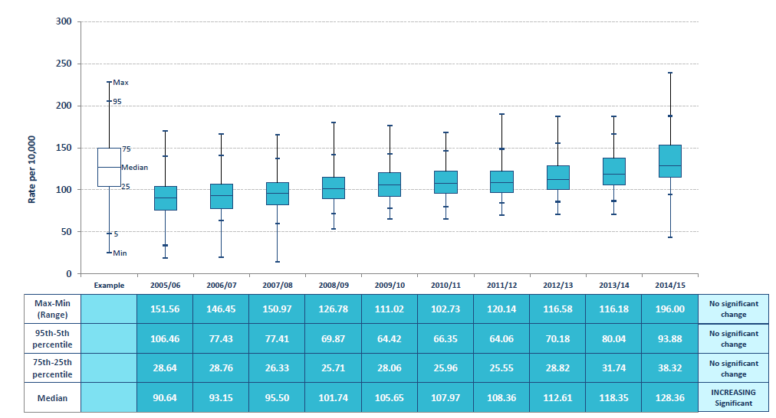
Box Plot 19: Rate of gastroscopy (upper gastrointestinal endoscopy) procedures per population by CCG
Indirectly standardised for age, sex and deprivation, 2014/15
Domain 1: Preventing people from dying prematurely
OPTIMUM VALUE: REQUIRES LOCAL INTERPRETATION

Slide 88
Map 20
December 2016

Slide 89
Map 20: Percentage of patients undergoing gastroscopy (upper gastrointestinal endoscopy) procedures aged under 55 years by CCG
2014/15
Domain 1: Preventing people from dying prematurely
OPTIMUM VALUE: LOW
LONDON
Contains Ordnance Survey data © Crown copyright and database right 2016
Contains National Statistics data © Crown copyright and database right 2016

Slide 90
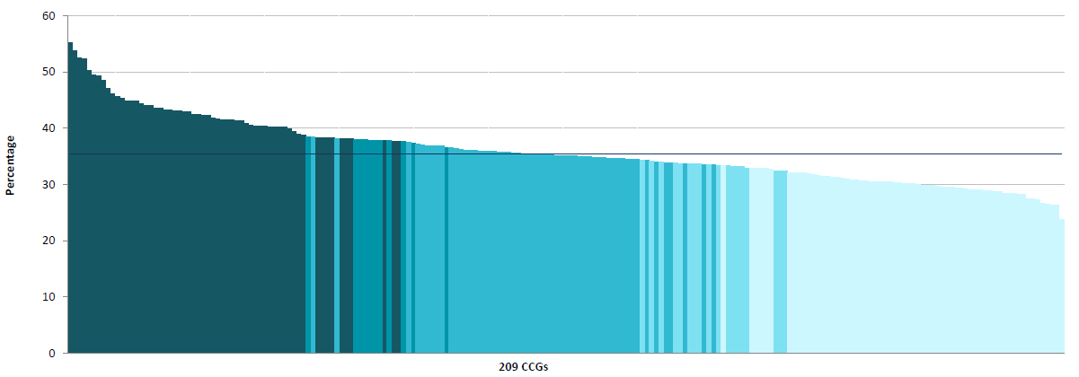
Column Chart 20: Percentage of patients undergoing gastroscopy (upper gastrointestinal endoscopy) procedures aged under 55 years by CCG
2014/15
Domain 1: Preventing people from dying prematurely
OPTIMUM VALUE: LOW

Slide 91
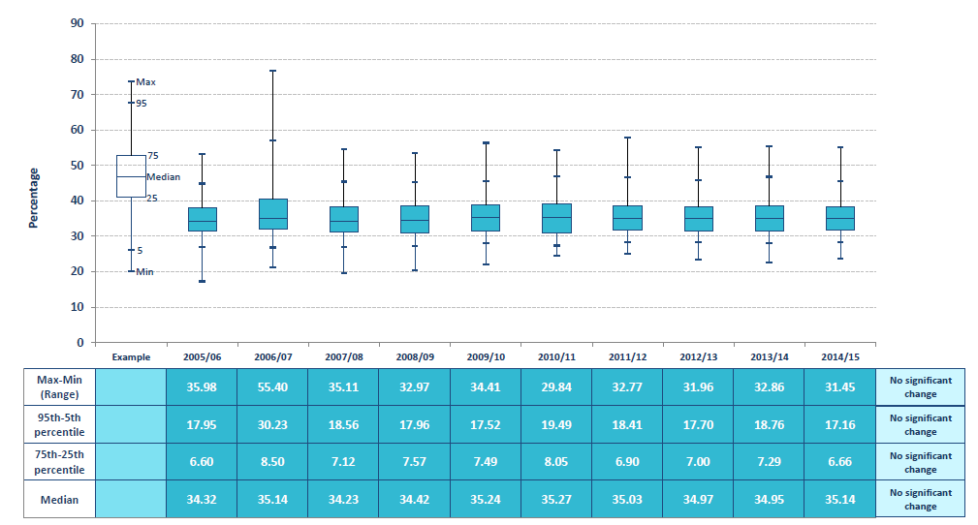
Box Plot 20: Percentage of patients undergoing gastroscopy (upper gastrointestinal endoscopy) procedures aged under 55 years by CCG
2014/15
Domain 1: Preventing people from dying prematurely
OPTIMUM VALUE: LOW

Slide 92
Map 21
December 2016

Slide 93
Map 21: Rate of capsule endoscopy procedures per population by CCG
Indirectly standardised for age, sex and deprivation, 2014/15
Domain 2: Enhancing quality of life for people with long-term conditions
OPTIMUM VALUE: REQUIRES LOCAL INTEPRETATION
LONDON
Contains Ordnance Survey data © Crown copyright and database right 2016
Contains National Statistics data © Crown copyright and database right 2016

Slide 94
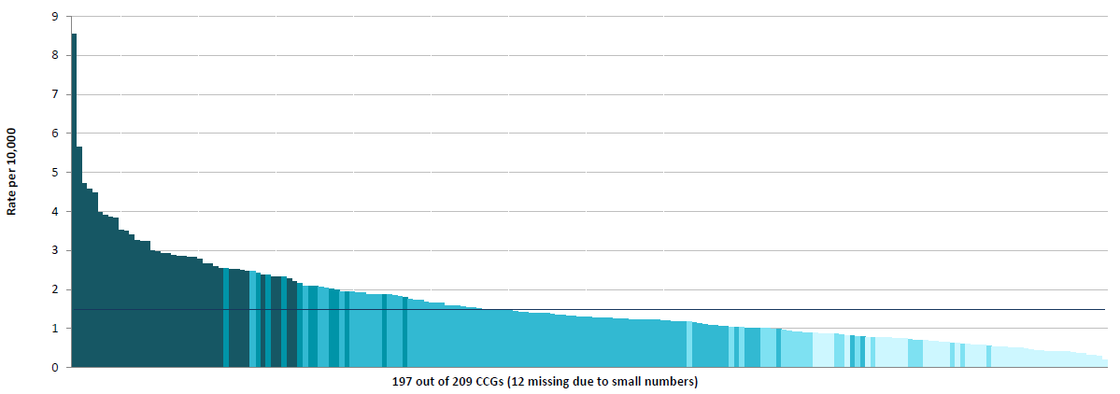
Column Chart 21: Rate of capsule endoscopy procedures per population by CCG
Indirectly standardised for age, sex and deprivation, 2014/15
Domain 2: Enhancing quality of life for people with long-term conditions
OPTIMUM VALUE: REQUIRES LOCAL INTEPRETATION

Slide 95
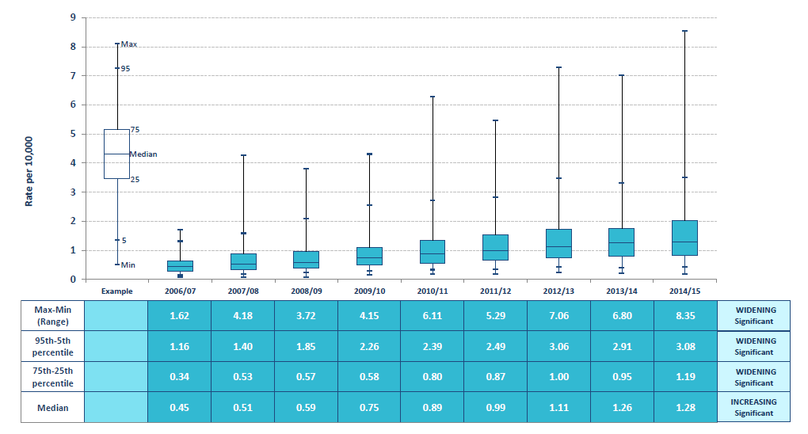
Box Plot 21: Rate of capsule endoscopy procedures per population by CCG
Indirectly standardised for age, sex and deprivation, 2014/15
Domain 2: Enhancing quality of life for people with long-term conditions
OPTIMUM VALUE: REQUIRES LOCAL INTEPRETATION

Slide 96
Map 22
December 2016

Slide 97
Map 22: Rate of endoscopic ultrasound procedures per population by CCG
Indirectly standardised for age, sex and deprivation, 2014/15
Domain 1: Preventing people from dying prematurely
Domain 2: Enhancing quality of life for people with long-term conditions
OPTIMUM VALUE: REQUIRES LOCAL INTERPRETATION
LONDON
Contains Ordnance Survey data © Crown copyright and database right 2016
Contains National Statistics data © Crown copyright and database right 2016

Slide 98
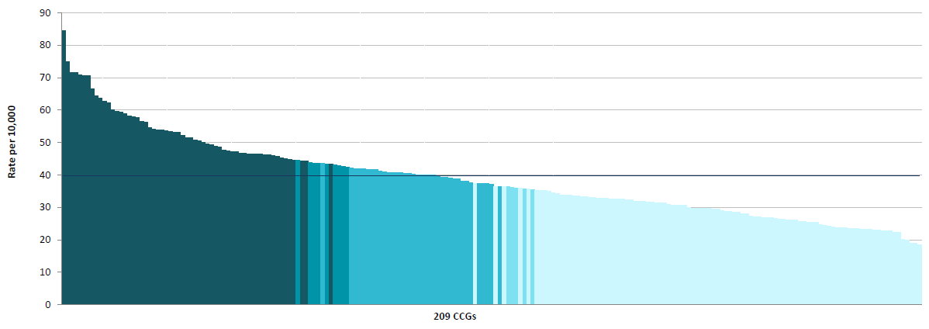
Column Chart 22: Rate of endoscopic ultrasound procedures per population by CCG
Indirectly standardised for age, sex and deprivation, 2014/15
Domain 1: Preventing people from dying prematurely
Domain 2: Enhancing quality of life for people with long-term conditions
OPTIMUM VALUE: REQUIRES LOCAL INTERPRETATION

Slide 99
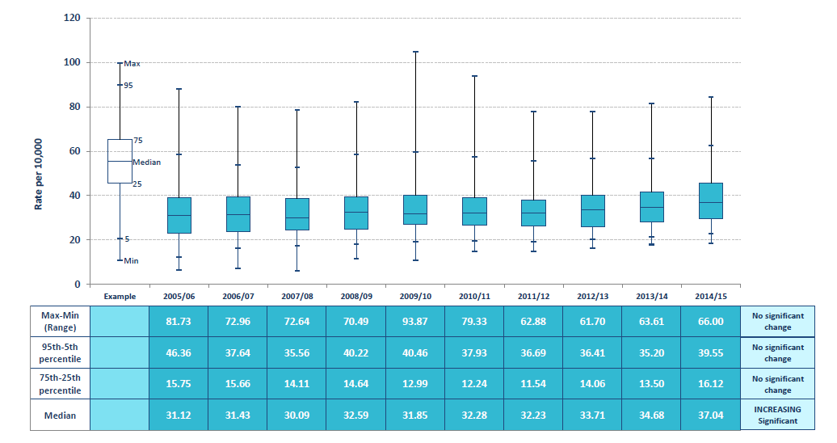
Box Plot 22: Rate of endoscopic ultrasound procedures per population by CCG
Indirectly standardised for age, sex and deprivation, 2014/15
Domain 1: Preventing people from dying prematurely
Domain 2: Enhancing quality of life for people with long-term conditions
OPTIMUM VALUE: REQUIRES LOCAL INTERPRETATION

Slide 100
Map 23
December 2016

Slide 101
Map 23: Admission rate for children for upper and/or lower gastro-intestinal endoscopy per population aged 0-17 years by CCG
Directly standardised for age, 2012/13-2014/15
Domain 2: Enhancing quality of life for people with long-term conditions
OPTIMUM VALUE: REQUIRES LOCAL INTERPRETATION
LONDON
Contains Ordnance Survey data © Crown copyright and database right 2016
Contains National Statistics data © Crown copyright and database right 2016

Slide 102
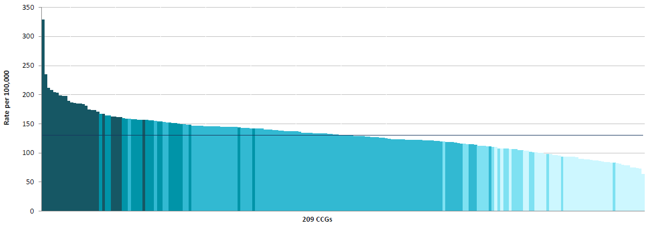
Column Chart 23: Admission rate for children for upper and/or lower gastro-intestinal endoscopy per population aged 0-17 years by CCG
Directly standardised for age, 2012/13-2014/15
Domain 2: Enhancing quality of life for people with long-term conditions
OPTIMUM VALUE: REQUIRES LOCAL INTERPRETATION

Slide 103
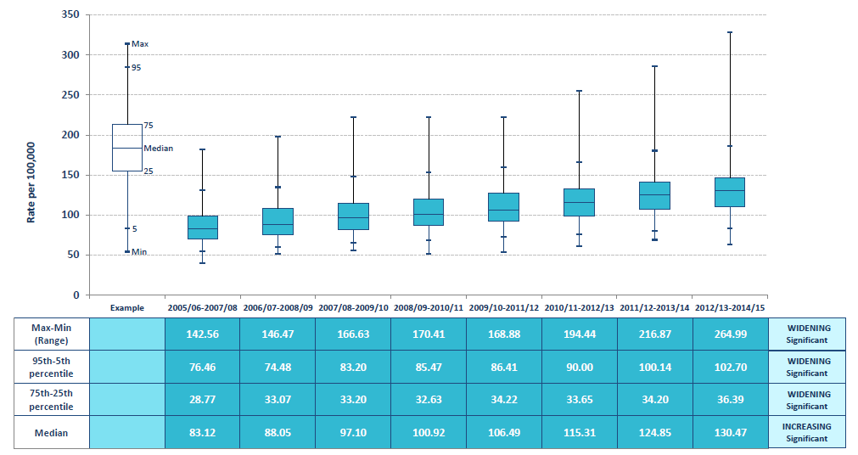
Box Plot 23: Admission rate for children for upper and/or lower gastro-intestinal endoscopy per population aged 0-17 years by CCG
Directly standardised for age, 2012/13-2014/15
Domain 2: Enhancing quality of life for people with long-term conditions
OPTIMUM VALUE: REQUIRES LOCAL INTERPRETATION

Slide 104
Map 24
December 2016

Slide 105
Map 24: Rate of audiology assessments undertaken per weighted population by CCG
Adjusted for age, sex and ‘need’, January-March 2016
Domain 2: Enhancing quality of life for people with long-term conditions
OPTIMUM VALUE: REQUIRES LOCAL INTERPRETATION
LONDON
Contains Ordnance Survey data © Crown copyright and database right 2016
Contains National Statistics data © Crown copyright and database right 2016

Slide 106
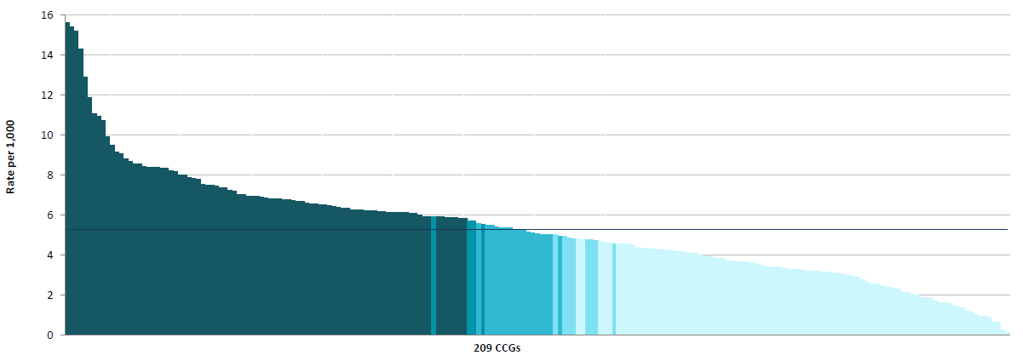
Column Chart 24: Rate of audiology assessments undertaken per weighted population by CCG
Adjusted for age, sex and ‘need’, January-March 2016
Domain 2: Enhancing quality of life for people with long-term conditions
OPTIMUM VALUE: REQUIRES LOCAL INTERPRETATION

Slide 107

Box Plot 24: Rate of audiology assessments undertaken per weighted population by CCG
Adjusted for age, sex and ‘need’, January-March 2016
Domain 2: Enhancing quality of life for people with long-term conditions
OPTIMUM VALUE: REQUIRES LOCAL INTERPRETATION

Slide 108
Physiological Services
December 2016

Slide 109
Map 25
December 2016

Slide 110
Map 25: Rate of diagnostic sleep studies undertaken per weighted population by CCG
Adjusted for age, sex and ‘need’, January-March 2016
Domain 2: Enhancing quality of life for people with long-term conditions
OPTIMUM VALUE: REQUIRES LOCAL INTERPRETATION
LONDON
Contains Ordnance Survey data © Crown copyright and database right 2016
Contains National Statistics data © Crown copyright and database right 2016

Slide 111

Column Chart 25: Rate of diagnostic sleep studies undertaken per weighted population by CCG
Adjusted for age, sex and ‘need’, January-March 2016
Domain 2: Enhancing quality of life for people with long-term conditions
OPTIMUM VALUE: REQUIRES LOCAL INTERPRETATION

Slide 112

Box Plot 25: Rate of diagnostic sleep studies undertaken per weighted population by CCG
Adjusted for age, sex and ‘need’, January-March 2016
Domain 2: Enhancing quality of life for people with long-term conditions
OPTIMUM VALUE: REQUIRES LOCAL INTERPRETATION

Slide 113
Map 26
December 2016

Slide 114
Map 26: Percentage of patients with COPD with a record of FEV1 in the previous 12 months by CCG
2014/15
Domain 1: Preventing people from dying prematurely
Domain 2: Enhancing quality of life for people with long-term conditions
OPTIMUM VALUE: HIGH
LONDON
Contains Ordnance Survey data © Crown copyright and database right 2016
Contains National Statistics data © Crown copyright and database right 2016

Slide 115

Column Chart 26: Percentage of patients with COPD with a record of FEV1 in the previous 12 months by CCG
2014/15
Domain 1: Preventing people from dying prematurely
Domain 2: Enhancing quality of life for people with long-term conditions
OPTIMUM VALUE: HIGH

Slide 116

Box Plot 26: Percentage of patients with COPD with a record of FEV1 in the previous 12 months by CCG
2014/15
Domain 1: Preventing people from dying prematurely
Domain 2: Enhancing quality of life for people with long-term conditions
OPTIMUM VALUE: HIGH

Slide 117
Map 27
December 2016

Slide 118
Map 27: Rate of urodynamic (pressures and flows) tests undertaken per weighted population by CCG
Adjusted for age, sex and ‘need’, January-March 2016
Domain 2: Enhancing quality of life for people with long-term conditions
OPTIMUM VALUE: REQUIRES LOCAL INTERPRETATION
LONDON
Contains Ordnance Survey data © Crown copyright and database right 2016
Contains National Statistics data © Crown copyright and database right 2016

Slide 119

Column Chart 27: Rate of urodynamic (pressures and flows) tests undertaken per weighted population by CCG
Adjusted for age, sex and ‘need’, January-March 2016
Domain 2: Enhancing quality of life for people with long-term conditions
OPTIMUM VALUE: REQUIRES LOCAL INTERPRETATION

Slide 120

Box Plot 27: Rate of urodynamic (pressures and flows) tests undertaken per weighted population by CCG
Adjusted for age, sex and ‘need’, January-March 2016
Domain 2: Enhancing quality of life for people with long-term conditions
OPTIMUM VALUE: REQUIRES LOCAL INTERPRETATION

Slide 121
Map 28
December 2016

Slide 122
Map 28: Rate of echocardiography activity undertaken per weighted population by CCG
Adjusted for age, sex and ‘need’, January-March 2016
Domain 2: Enhancing quality of life for people with long-term conditions
OPTIMUM VALUE: REQUIRES LOCAL INTERPRETATION
LONDON
Contains Ordnance Survey data © Crown copyright and database right 2016
Contains National Statistics data © Crown copyright and database right 2016

Slide 123

Column Chart 28: Rate of echocardiography activity undertaken per weighted population by CCG
Adjusted for age, sex and ‘need’, January-March 2016
Domain 2: Enhancing quality of life for people with long-term conditions
OPTIMUM VALUE: REQUIRES LOCAL INTERPRETATION

Slide 124

Box Plot 28: Rate of echocardiography activity undertaken per weighted population by CCG
Adjusted for age, sex and ‘need’, January-March 2016
Domain 2: Enhancing quality of life for people with long-term conditions
OPTIMUM VALUE: REQUIRES LOCAL INTERPRETATION

Slide 125
Map 29
December 2016

Slide 126
Map 29: Rate of peripheral neurophysiology tests undertaken per weighted population by CCG
Adjusted for age, sex and ‘need’, January-March 2016
Domain 2: Enhancing quality of life for people with long-term conditions
OPTIMUM VALUE: REQUIRES LOCAL INTERPRETATION
LONDON
Contains Ordnance Survey data © Crown copyright and database right 2016
Contains National Statistics data © Crown copyright and database right 2016

Slide 127

Column Chart 29: Rate of peripheral neurophysiology tests undertaken per weighted population by CCG
Adjusted for age, sex and ‘need’, January-March 2016
Domain 2: Enhancing quality of life for people with long-term conditions
OPTIMUM VALUE: REQUIRES LOCAL INTERPRETATION

Slide 128

Box Plot 29: Rate of peripheral neurophysiology tests undertaken per weighted population by CCG
Adjusted for age, sex and ‘need’, January-March 2016
Domain 2: Enhancing quality of life for people with long-term conditions
OPTIMUM VALUE: REQUIRES LOCAL INTERPRETATION

Slide 129
Screening Services
December 2016

Slide 130
Map 30
December 2016

Slide 131
Map 30: Percentage coverage for initial screening tests for men aged 65 years in the NHS abdominal aortic aneurysm (AAA) screening programme by CCG
2014/15
Domain 1: Preventing people from dying prematurely
OPTIMUM VALUE: HIGH
LONDON
Contains Ordnance Survey data © Crown copyright and database right 2016
Contains National Statistics data © Crown copyright and database right 2016

Slide 132

Column Chart 30: Percentage coverage for initial screening tests for men aged 65 years in the NHS abdominal aortic aneurysm (AAA) screening programme by CCG
2014/15
Domain 1: Preventing people from dying prematurely
OPTIMUM VALUE: HIGH

Slide 133

Box Plot 30: Percentage coverage for initial screening tests for men aged 65 years in the NHS abdominal aortic aneurysm (AAA) screening programme by CCG
2014/15
Domain 1: Preventing people from dying prematurely
OPTIMUM VALUE: HIGH

Slide 134
Map 31
December 2016

Slide 135
Map 31: Percentage of eligible people aged 60-74 years with a screening test result recorded in the previous 2.5 years from the NHS bowel cancer screening programme (NHS BCSP) by upper-tier local authority
At 31 March 2015
Domain 1: Preventing people from dying prematurely
OPTIMUM VALUE: HIGH
LONDON
Contains Ordnance Survey data © Crown copyright and database right 2016
Contains National Statistics data © Crown copyright and database right 2016

Slide 136

Column Chart 31: Percentage of eligible people aged 60-74 years with a screening test result recorded in the previous 2.5 years from the NHS bowel cancer screening programme (NHS BCSP) by upper-tier local authority
At 31 March 2015
Domain 1: Preventing people from dying prematurely
OPTIMUM VALUE: HIGH

Slide 137

Box Plot 31: Percentage of eligible people aged 60-74 years with a screening test result recorded in the previous 2.5 years from the NHS bowel cancer screening programme (NHS BCSP) by upper-tier local authority
At 31 March 2015
Domain 1: Preventing people from dying prematurely
OPTIMUM VALUE: HIGH

Slide 138
Map 32
December 2016

Slide 139
Map 32: Percentage of eligible women aged 53-70 years screened adequately within the previous three years in the NHS breast screening programme (NHS BSP) by upper-tier local authority
At 31 March 2015
Domain 1: Preventing people from dying prematurely
OPTIMUM VALUE: HIGH
LONDON
Contains Ordnance Survey data © Crown copyright and database right 2016
Contains National Statistics data © Crown copyright and database right 2016

Slide 140

Column Chart 32: Percentage of eligible women aged 53-70 years screened adequately within the previous three years in the NHS breast screening programme (NHS BSP) by upper-tier local authority
At 31 March 2015
Domain 1: Preventing people from dying prematurely
OPTIMUM VALUE: HIGH

Slide 141

Box Plot 32: Percentage of eligible women aged 53-70 years screened adequately within the previous three years in the NHS breast screening programme (NHS BSP) by upper-tier local authority
At 31 March 2015
Domain 1: Preventing people from dying prematurely
OPTIMUM VALUE: HIGH

Slide 142
Map 33
December 2016

Slide 143
Map 33: Percentage of eligible women aged 25-64 years screened adequately in the NHS cervical screening programme (NHS CSP) by upper-tier local authority
At 31 March 2015
Domain 1: Preventing people from dying prematurely
OPTIMUM VALUE: HIGH
LONDON
Contains Ordnance Survey data © Crown copyright and database right 2016
Contains National Statistics data © Crown copyright and database right 2016

Slide 144

Column Chart 33: Percentage of eligible women aged 25-64 years screened adequately in the NHS cervical screening programme (NHS CSP) by upper-tier local authority
At 31 March 2015
Domain 1: Preventing people from dying prematurely
OPTIMUM VALUE: HIGH

Slide 145

Box Plot 33: Percentage of eligible women aged 25-64 years screened adequately in the NHS cervical screening programme (NHS CSP) by upper-tier local authority
At 31 March 2015
Domain 1: Preventing people from dying prematurely
OPTIMUM VALUE: HIGH

Slide 146
Map 34
December 2016

Slide 147
Map 34: Percentage of babies eligible for testing in the NHS newborn blood spot (NBS) screening programme who had a conclusive result recorded on the Child Health Information System (CHIS) within an effective timeframe by CCG
July-September 2015
Domain 1: Preventing people from dying prematurely
Domain 2: Enhancing quality of life for people with long-term conditions
OPTIMUM VALUE: HIGH
LONDON
Contains Ordnance Survey data © Crown copyright and database right 2016
Contains National Statistics data © Crown copyright and database right 2016

Slide 148

Column Chart 34: Percentage of babies eligible for testing in the NHS newborn blood spot (NBS) screening programme who had a conclusive result recorded on the Child Health Information System (CHIS) within an effective timeframe by CCG
July-September 2015
Domain 1: Preventing people from dying prematurely
Domain 2: Enhancing quality of life for people with long-term conditions
OPTIMUM VALUE: HIGH

Slide 149

Box Plot 34: Percentage of babies eligible for testing in the NHS newborn blood spot (NBS) screening programme who had a conclusive result recorded on the Child Health Information System (CHIS) within an effective timeframe by CCG
July-September 2015
Domain 1: Preventing people from dying prematurely
Domain 2: Enhancing quality of life for people with long-term conditions
OPTIMUM VALUE: HIGH

Slide 150
Map 35
December 2016

Slide 151
Map 35: Percentage of babies who required a repeat test due to an avoidable failure in the sampling process during the NHS newborn blood spot (NBS) screening programme by maternity service
July-September 2015
Domain 1: Preventing people from dying prematurely
Domain 2: Enhancing quality of life for people with long-term conditions
OPTIMUM VALUE: LOW
LONDON
Contains Ordnance Survey data © Crown copyright and database right 2016
Contains National Statistics data © Crown copyright and database right 2016

Slide 152

Column Chart 35: Percentage of babies who required a repeat test due to an avoidable failure in the sampling process during the NHS newborn blood spot (NBS) screening programme by maternity service
July-September 2015
Domain 1: Preventing people from dying prematurely
Domain 2: Enhancing quality of life for people with long-term conditions
OPTIMUM VALUE: LOW

Slide 153

Box Plot 35: Percentage of babies who required a repeat test due to an avoidable failure in the sampling process during the NHS newborn blood spot (NBS) screening programme by maternity service
July-September 2015
Domain 1: Preventing people from dying prematurely
Domain 2: Enhancing quality of life for people with long-term conditions
OPTIMUM VALUE: LOW

Slide 154
Map 36
December 2016

Slide 155
Map 36: Percentage of referred babies who had an audiological assessment within four weeks of the decision to refer or by 44 weeks’ gestational age by CCG
2014/15
Domain 2: Enhancing quality of life for people with long-term conditions
OPTIMUM VALUE: HIGH
LONDON
Contains Ordnance Survey data © Crown copyright and database right 2016
Contains National Statistics data © Crown copyright and database right 2016

Slide 156

Column Chart 36: Percentage of referred babies who had an audiological assessment within four weeks of the decision to refer or by 44 weeks’ gestational age by CCG
2014/15
Domain 2: Enhancing quality of life for people with long-term conditions
OPTIMUM VALUE: HIGH

Slide 157

Box Plot 36: Percentage of referred babies who had an audiological assessment within four weeks of the decision to refer or by 44 weeks’ gestational age by CCG
2014/15
Domain 2: Enhancing quality of life for people with long-term conditions
OPTIMUM VALUE: HIGH

Slide 158
Map 37
December 2016

Slide 159
Map 37: Percentage of women tested in the NHS antenatal sickle cell and thalassaemia screening programme with a conclusive result by 10 weeks’ gestation by NHS Trust
July-September 2015
Domain 4: Ensuring that people have a positive experience of care
OPTIMUM VALUE: HIGH
LONDON
Contains Ordnance Survey data © Crown copyright and database right 2016
Contains National Statistics data © Crown copyright and database right 2016

Slide 160

Column Chart 37: Percentage of women tested in the NHS antenatal sickle cell and thalassaemia screening programme with a conclusive result by 10 weeks’ gestation by NHS Trust
July-September 2015
Domain 4: Ensuring that people have a positive experience of care
OPTIMUM VALUE: HIGH

Slide 161

Box Plot 37: Percentage of women tested in the NHS antenatal sickle cell and thalassaemia screening programme with a conclusive result by 10 weeks’ gestation by NHS Trust
July-September 2015
Domain 4: Ensuring that people have a positive experience of care
OPTIMUM VALUE: HIGH

Slide 162
Map 38
December 2016

Slide 163
Map 38: Percentage of samples in the NHS antenatal sickle cell and thalassaemia screening programme submitted to the laboratory with a completed family origin questionnaire (FOQ) by maternity service
July-September 2015
Domain 4: Ensuring that people have a positive experience of care
OPTIMUM VALUE: HIGH
LONDON
Contains Ordnance Survey data © Crown copyright and database right 2016
Contains National Statistics data © Crown copyright and database right 2016

Slide 164

Column Chart 38: Percentage of samples in the NHS antenatal sickle cell and thalassaemia screening programme submitted to the laboratory with a completed family origin questionnaire (FOQ) by maternity service
July-September 2015
Domain 4: Ensuring that people have a positive experience of care
OPTIMUM VALUE: HIGH

Slide 165

Box Plot 38: Percentage of samples in the NHS antenatal sickle cell and thalassaemia screening programme submitted to the laboratory with a completed family origin questionnaire (FOQ) by maternity service
July-September 2015
Domain 4: Ensuring that people have a positive experience of care
OPTIMUM VALUE: HIGH

