Slide 1
Local Tobacco Control Profiles Thursday 4th March
March 2021 update
https://fingertips.phe.org.uk/profile/tobacco-control

Slide 2
This week’s update contained….
QOF & GPPS smoking prevalence 2019/20
GPPS smoking in adults with a long-term mental health condition (% and gap)
NDTMS 2019/20
Emergency hospital admissions for COPD
Hospital admissions for asthma
Low birth weight of term babies
Smoking quitters

Slide 3
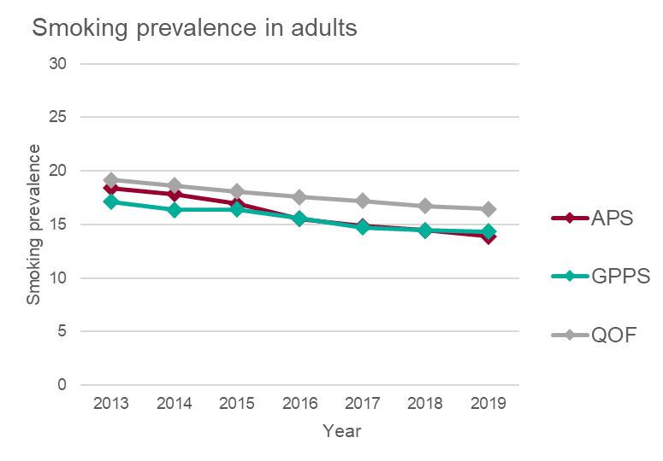
Smoking prevalence estimates

Slide 4
About the datasets

Slide 5
When to use?
APS
Population health monitoring
Monitoring against the Tobacco Control Plan target
Inequalities data
GPPS
Comparing population with a long term mental health condition
QOF
Specific interest in GP practices

Slide 6
Smoking prevalence in adults (18+) - GPPS

Slide 7
Smoking Prevalence in adults (18+) by MH status

Slide 8
Smoking prevalence in adults (18+) – gap by mental health status

Slide 9
Smoking prevalence in adults with a long term mental health condition (18+) – current smokers

Slide 10
Smoking and mental health

Slide 11
Trends in smoking prevalence (NDTMS) – all substance

Slide 12
Smoking Prevalence (NDTMS) by substance

Slide 13
Smoking in high prevalence groups

Slide 14
Smokers setting a quit date
Smokers setting a quit date, per 100,000 smokers
Smokers that have successfully quit at 4 weeks, per 100,000 smokers

Slide 15
Smoking Quitters

Slide 16
Further resources

Slide 17
Further resources - examples

Slide 18
Changes to layout

Slide 19
Changes to layout

Slide 20
Questions or feedback on the webinar
tobacco.profiles@phe.gov.uk

