Slide 1
Local Tobacco Control Profiles The webinar will start at 1:00pm
March 2019 update
www.tobaccoprofiles.info

Slide 2
Introduction
Overview
Data updated today
Calculation of smoking attributable hospital admissions indicator
At-a-glance
Further resources

Slide 3
Overview
Notes:
By way of overview, starting with the front page of the tool, which will look familiar of you have seen any of the fingertips tools, there is some information in the centre there about why the tool was developed but essentially the indicators have been designed to help local government and health services to assess the effect of tobacco use on their local populations. On this front page you can also see what has been updated when on the recent updates section on the right hand side.

Slide 4
Navigation around the profiles
Notes:
The indicators have been organised into 5 domains, highlighted here with the key indicators domain also collating the most widely used indicators from across the other 5 domains.
We have smoking prevalence in adults which contains the smoking prevalence calculated from various survey data sources, also smoking prevalence related to mental health issues and smoking in pregnancy. Then smoking in young people currently has the smoking stats for children age 15, smoking related mortality contains the mortality rates for various conditions that can be related to smoking such as lung cancer as well as the smoking attributable mortality indicator. Smoking related ill health, impact of smoking for things such as illicit tobacco and fires related to smoking materials and finally the quitters indicators which are calculated from the stop smoking services data published by NHS digital.
For each domain you have the different options of ways to view the indicators, which I’m not going to go through now as hopefully most of you are familiar with these in the fingertips tools.

Slide 5
5th March LTCP update:
SMOKING RELATED ILL HEALTH DOMAIN
Updated data for 2015-17 hospital admissions:
Smoking attributable hospital admissions
Emergency hospital admissions for COPD
Hospital admission for asthma (under 19 years)
Updated data for 2015-17 for premature births
Updated data for low birth weight of term babies for 2017
Notes:
Now looking at what was updated today, all the indicators are in the smoking related ill health domain, which is designed to look at various health issues with well-known links to smoking. Firstly 3 indicator related to hospital admissions were updated and also the back series was recalculated due to the revisions in the ONS mid-year population estimates which were used. We also added a new data point for premature births and low birth weight of term babies.

Slide 6
Smoking related ill heath domain England overview
Notes:
This is the England overview for the whole domain, which shows the values and change from last period. The indicators updated today are flagged as new data so if we just concentrate on these You can see that premature births have significantly increased from the last time period, while hosp admissions for asthma and smoking attributable hospital admissions have decreased and the others have remained similar.

Slide 7
Smoking attributable fractions
Current smokers
Ex-smokers
Relative risk for diseases such as:
Malignant neoplasms
Cardiovascular Diseases:
Respiratory Diseases
Diseases of the digestive system
Age
Groups
Males and females separately
Notes:
Next I’m going to take you through the calculation of the smoking attributable hospital admissions indicator, which I appreciate some of you will already know, but we do receive queries regarding the calculation and interpretation of this indicator so I thought this might be helpful. The first thing needed for the calculations are the smoking attributable fractions. To calculate these we look at the relative risks of various diseases so for example a males smoker over 35 has 23 times the risk of getting lung cancer compared to a non-smoker, an ex-smoker has nearly 9 times the risk etc. This is then multiplied by the smoking prevalence for the corresponding value for current smokers or ex-smokers, for males or females and then for the affected age groups. We then extract the deaths for these same diseases and apply the fractions to them before calculating the age standardised rate.

Slide 8
Indicator calculation
SAFs
Observed hospital admissions for each locality, condition,
5-year age group, extracted from HES
applied
European
standard
Population (ESP) for each age group
Sum for each locality
Corresponding ONS mid-year population estimate for each locality, condition,
5-year age group
100,000
Sum of ESP for relevant age groups (35+)
Notes:
These SAFs are then applied to the observed hospital admissions, for each locality, 5 year age group and condition which we extract from the hospital episode statistics data. We then divide this by the population estimates for each corresponding 5 year age group in each locality and multiply that by the European standard population for each of the 5 year age bands. The results are then summed for each geography and then the total is divided by the total for the European standard pop for age 35+. Finally this is multiplied by 100,000 to get the age standardised rate per 100,000 population, meaning that for every 100,000 people in the population we find this number of people in hospital due to their smoking.

Slide 9
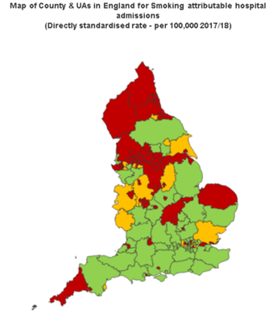
Smoking attributable hospital admissions
Notes:
And the latest results show that for England there were 1530 hospital admissions attributable to smoking in the 2017/18 period. The chart here shows the downward trend in recent years, but note the line on the chart which shows there was a change in methodology at this point and therefore any trend across this should be treated with caution. Variation remains across the country, with rates ranging from 721 per 100,000 in Wokingham to 2990 in Blackpool.

Slide 10
Inequalities
Notes:
Furthermore there is wide variation between deprivation deciles, with the most deprived having almost twice the rate of hospital admissions as the least deprived which is a serious health inequality and cause for concern.

Slide 11
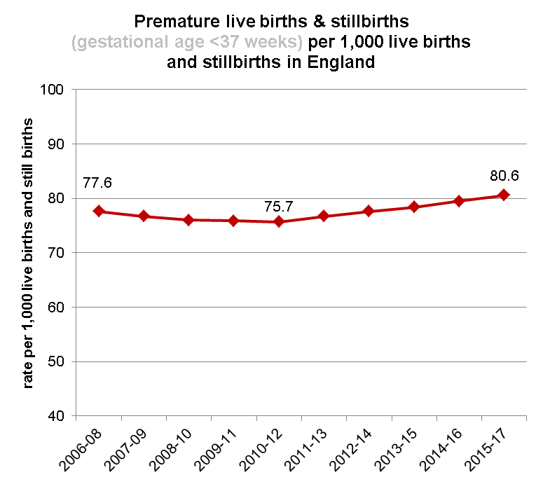
Births
Globally premature birth (less than 37 weeks gestation) is the leading cause of death for children under the age of 5¹.
There is substantial evidence that smoking during pregnancy and exposure to second-hand-smoke can lead to premature birth² among many other adverse health effects including complications during labour, low birth-weight at full term and increased risk of miscarriage and stillbirth.
1. http://www.who.int/mediacentre/factsheets/fs363/en/
2. http://thelancet.com/journals/lancet/article/PIIS0140-6736(14)60082-9/abstract
Low birth weight (<2500g) of term babies
Notes:
We include the data on premature births and low birth weight because there are well known links between smoking during pregnancy and exposure to second hand smoke and both of these. This chart shows the trend in premature births and by that we mean before 37 weeks gestation. It is concerning that in recent years there have been significant increases in the rates of premature births but we have contacted ONS about this and they do not know of any reason for it. Here we have the trend in babies born at full term but weighing less than 2500g has remained stable in recent years.

Slide 12
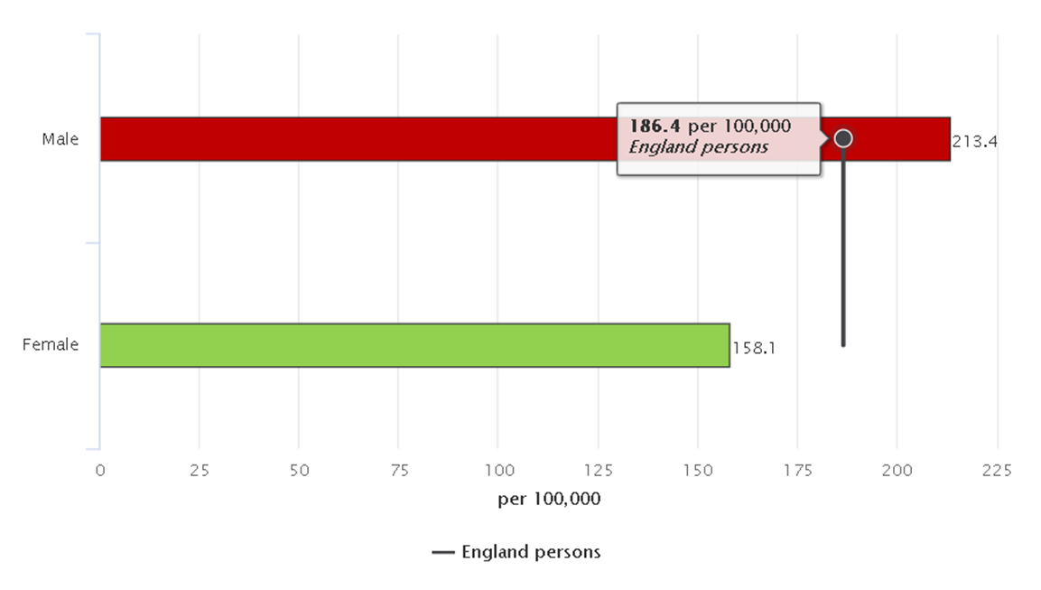
Hospital admissions for asthma and COPD
It is well documented that tobacco smoke is a strong risk factor for developing asthma (1) and exposure to second-hand smoke can be particularly harmful to the lungs of asthma sufferers (2).
1. http://www.who.int/mediacentre/factsheets/fs307/en/
2.https://www.asthma.org.uk/advice/triggers/smoking/?gclid=CMLblOD7tNICFcEcGwodo-AOrA
Hospital admissions for asthma (under 19 years)
Emergency hospital admissions for COPD
Notes:
Finally for the indicators updated today we have the hospital admissions for asthma in young people so age under 19, which had a rate of 186 per 100,000 population but interestingly as shown in this chart we see that boys had significantly higher rates than girls. Similarly with emergency hospital admissions for COPD the rates in males were significantly higher than females.

Slide 13
At-a-glance summaries
Notes:
Now looking at the at-a-glance summaries, which can be found on the downloads tab as shown here. These have replaced the previous PDF documents that were increasingly less looked at and downloaded in the hope that they can provide you with a quick overview of all the indicators at-a-glance, as the name suggests.

Slide 14
Notes:
If we zoom in on the download section here you can see that there are different area types for which you can get the at-a-glance and this depends on which you have selected from the dropdown lists at the top. This example shows when county and UA are selected and the LA Derby. Firstly if you click on the word England you will be taken to an overview of the England figures in the profiles.

Slide 15
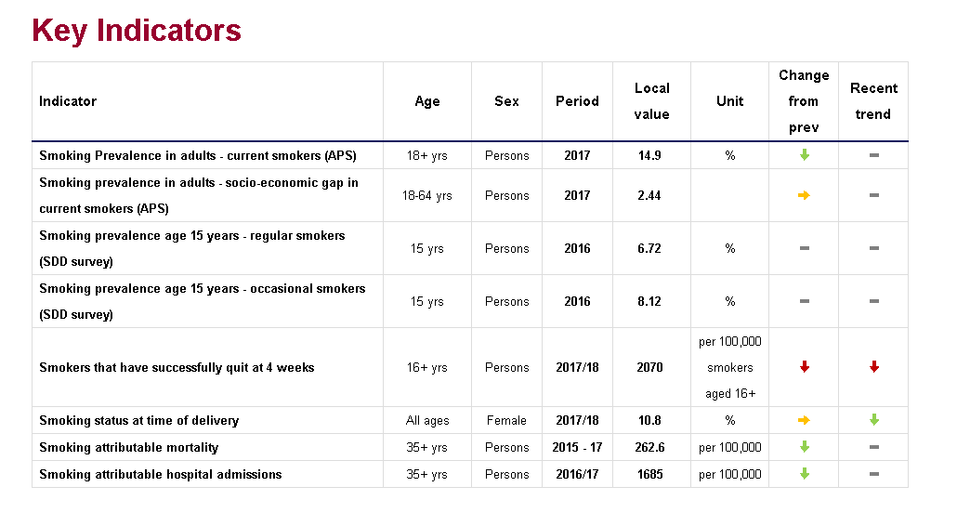
National at-a-glance
Notes:
At the top of the page is some text that explains about the colour coding and arrows throughout the rest of the page, and some things to note when interpreting the tables. Then for each domain you can see an overview of the indicators with their latest values and arrows indicator whether the recent changes have been going up or down and whether that is good so for example here the smoking prevalence is going down which is good so the arrow is coloured green, but successful quitters is going down which is not good so that is coloured red.

Slide 16
Regional/LA at-a-glance
Notes:
The difference you will notice when looking at the regional and local authority at-a-glance is that the values are RAG rated as in the overview tab. Also the list of indicators may change depending in whether data is available at the level you are looking at so for example district & ua will have a shorter list than county & ua.

Slide 17
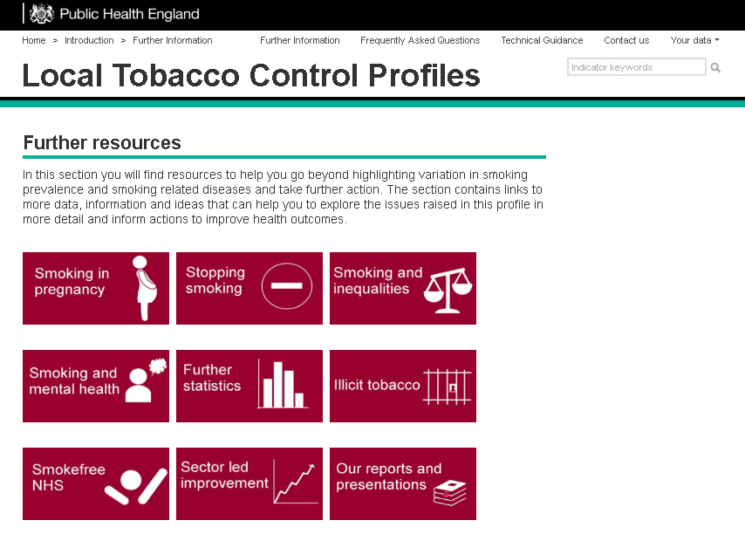
Further resources
Notes:
Moving on to the further resources section, you can get to this from any page on the profiles by clicking at the top of the page and you will be taken to this page. We recently updated the look of the page to make it more useful.

Slide 18
Further resources
Short section explaining context
Links to useful documents & webpages

Slide 19
Further resources
Grouped by sub-headings:
Data and evidence
Training and assessment
Tools
E-cigarettes
Campaigns

Slide 20
Further resources
Posters presented at conferences
Webinars
Other presentations

Slide 21
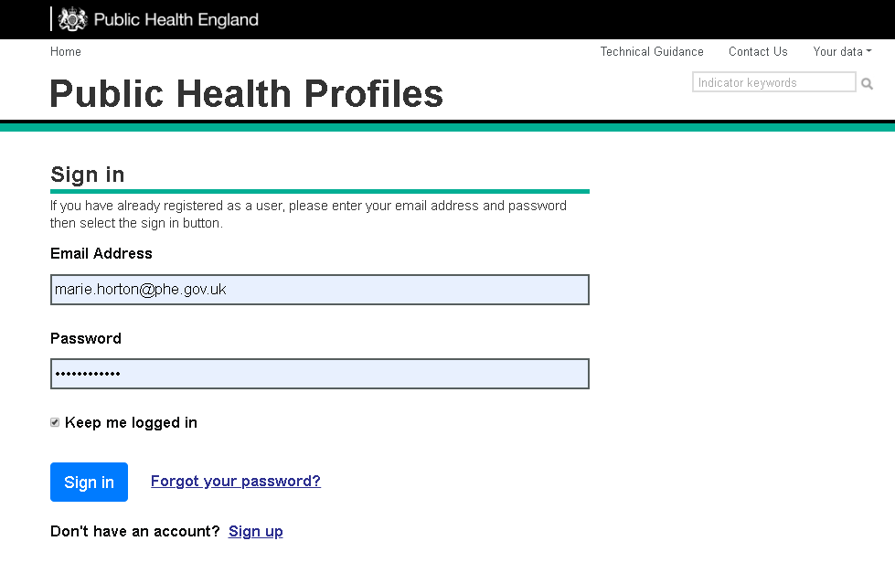
User-defined lists
Notes:
In order to set up your own list of indicators from across various Fingertips profiles you need to set up an account first….

Slide 22
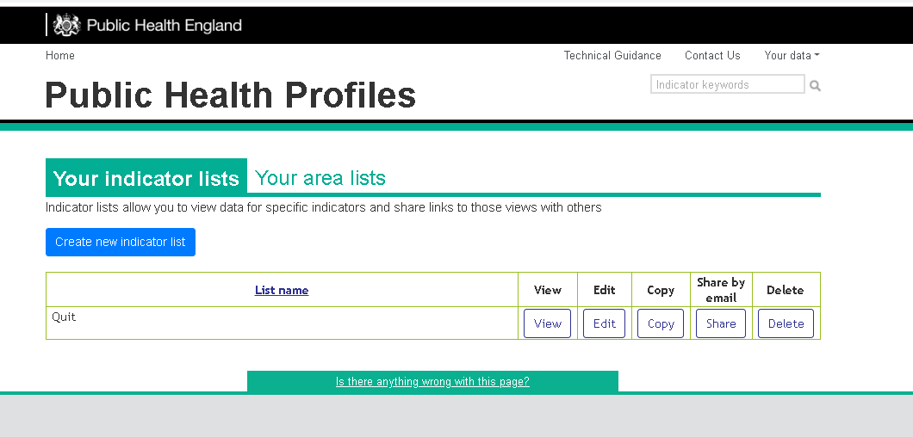
User-defined lists
Notes:
Then create a list…
-Type in a search term

Slide 23
Example list
Notes:
Drag the indicators you want in your list across from the left hand side to the right and save.

Slide 24
Feedback on the webinar
tobacco.profiles@phe.gov.uk

