Slide 1
Local Tobacco Control Profiles
The webinar will start at 1pm
November 2017 update
www.tobaccoprofiles.info
Notes:
Introduce myself

Slide 2

Webinar guidance
Please mute your microphone
Use the Instant Messenger function to ask questions or to comment
There will be some Q&A time at the end of the webinar
Notes:
Highlight this to the audience…

Slide 3
Today’s update
Updated 18 indicators
Smoking status at time of delivery
Smoking prevalence at age 15
Smoking attributable mortality
Illicit tobacco
Smoking quitters
One new indicator added
Smoking status at time of delivery
Inequalities data added
Sexual identity for smoking prevalence indicators (APS)
Back series for smoking prevalence in R&M occupations (APS)

Slide 4
Smoking status at time of delivery
New indicator added to the tool for new method
Current method – 10.7% Historical method – 10.5%
No. of women known to smoke No. of women known to smoke
at time of delivery at time of delivery
No. of maternities where smoking Total no. of maternities
status is known
2% of maternities currently have no smoking status recorded.

Slide 5
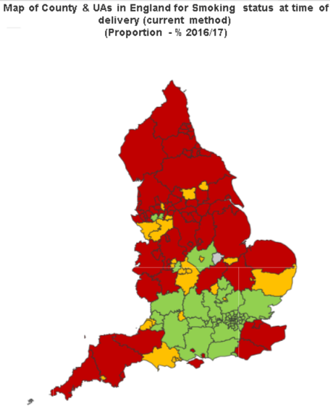
Smoking status at time of delivery
TARGET 6%
has been met by
29 LA’s
83 LA’s significantly worse than England average of 10.7%
and range up to 28%

Slide 6
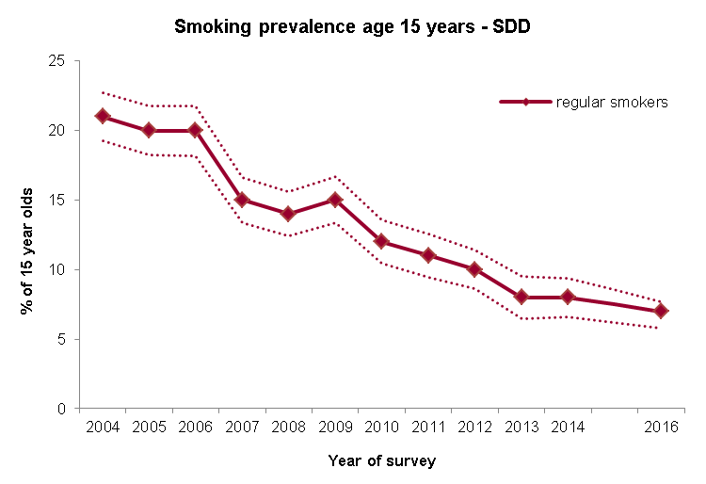
Smoking prevalence in young people
Smoking, drinking and drug use survey (SDD)

Slide 7
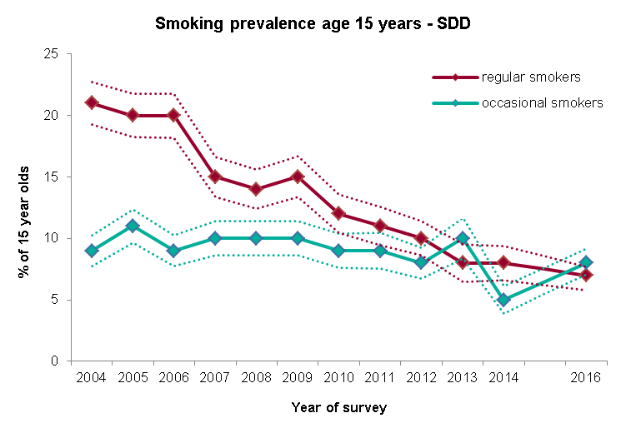
Smoking prevalence in young people
Smoking, drinking and drug use survey (SDD)

Slide 8
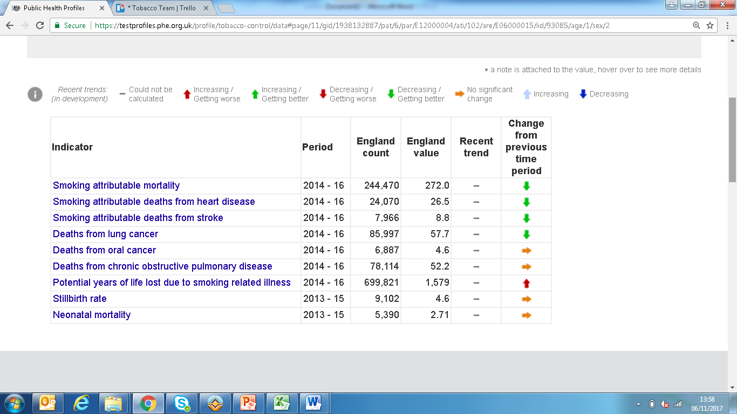
Smoking related mortality

Slide 9
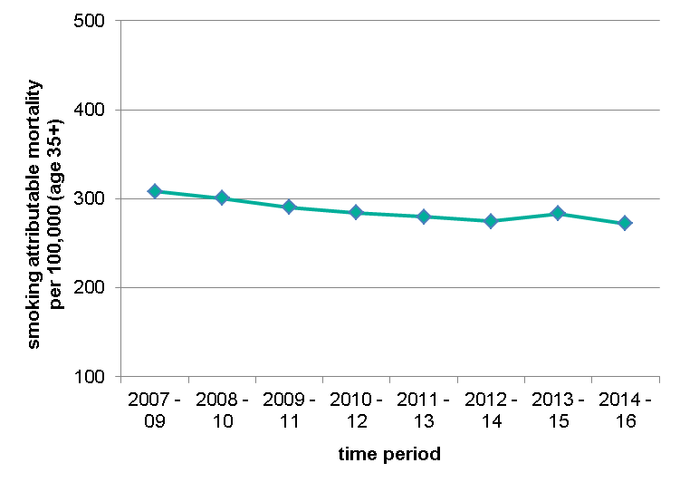
Smoking related mortality
Deaths attributable to smoking, directly age-sex standardised rate for persons aged 35 years +
Relative risks:
Various cancers (e.g. lung, oral, oesophagus)
Cardiovascular and respiratory diseases (e.g. COPD)
Circulatory diseases
Change in method

Slide 10
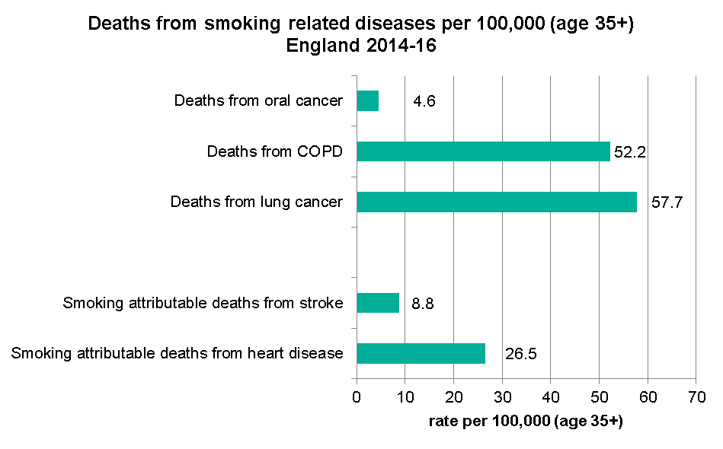
Smoking related mortality

Slide 11
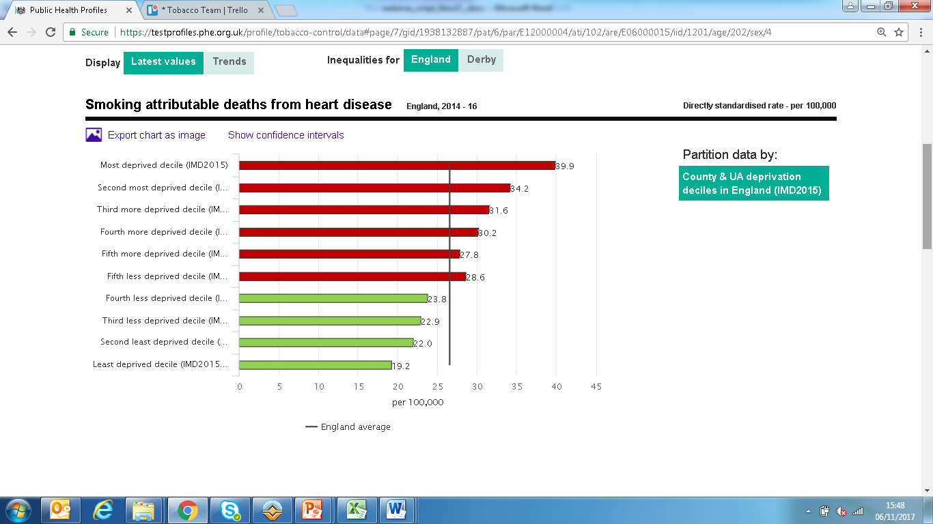
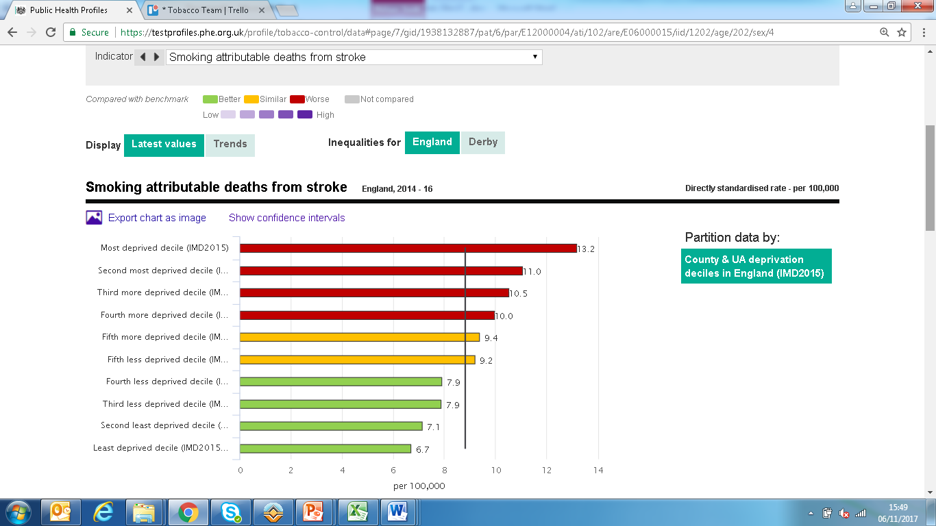
Smoking related mortality

Slide 12
Smoking related mortality

Slide 13
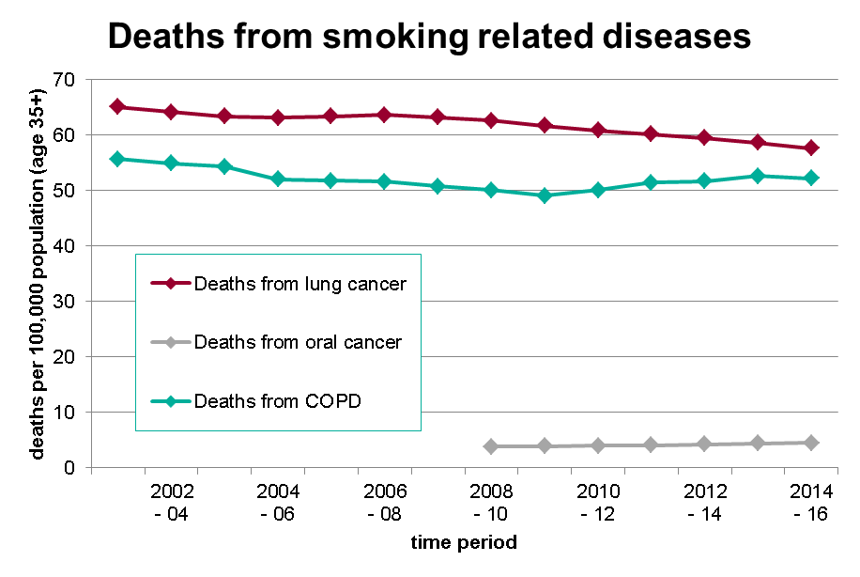
Smoking related mortality

Slide 14
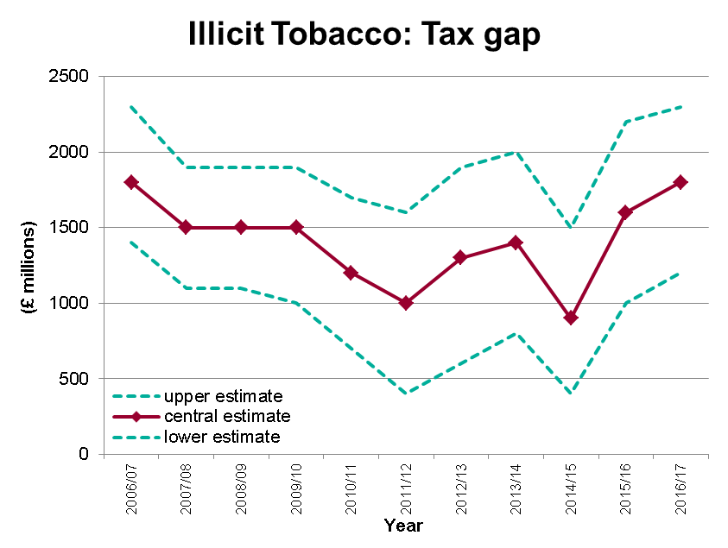
Illicit tobacco

Slide 15
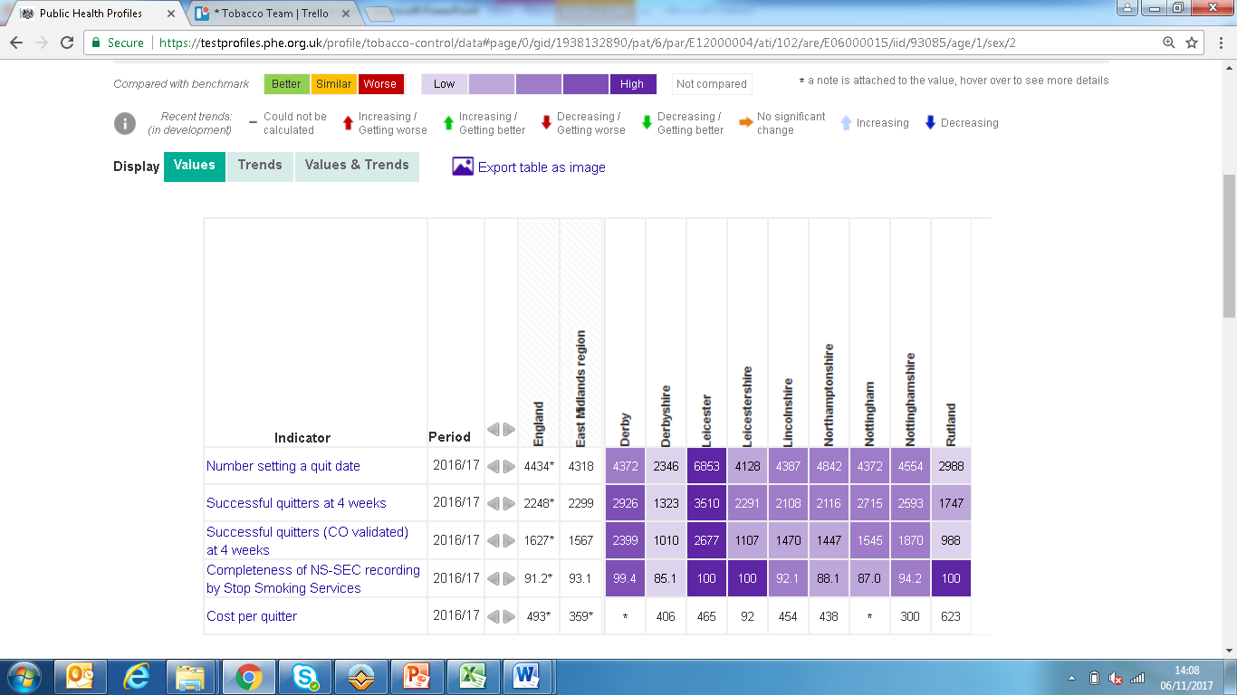
Smoking quitters

Slide 16
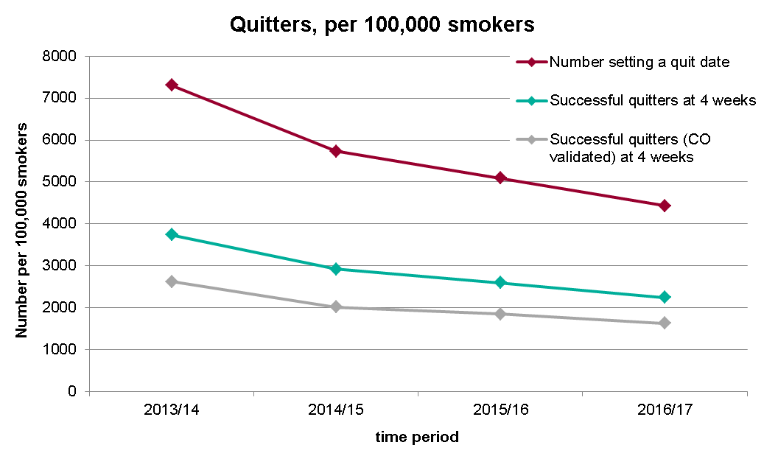
Smoking quitters

Slide 17

Questions?
Notes:
We now have time for some extra questions. As at the beginning, please use the instant messenger function.

Slide 18
Feedback on the webinar
tobacco.profiles@phe.gov.uk
Notes:
Any feedback on improvements for future webinars, please send this to the email address on the screen.

